Slide 1
Pre-funding your retirement taxes
TEMPLATE: THIS SLIDE MAY BE REMOVED BASED ON PRESENTER
Help protect your family today, and address your tax picture in the future
Insurance products issued by Minnesota Life Insurance Company | Securian Life Insurance Company
Notes:
<Note to presenter: use this slide when Securian Financial home office, product line wholesaler, or regional vice president delivers the seminar.
This presentation is laid out with all content, including what would normally be speakers notes, on screen to facilitate remote presentation.>
General introductions

Slide 2
Pre-funding your retirement taxes
TEMPLATE: THIS SLIDE MAY BE REMOVED BASED ON PRESENTER
Help protect your family today, and address your tax picture in the future
Presenter name
Title
<firm contact information>
<firm disclosures>
Insurance products issued by Minnesota Life Insurance Company | Securian Life Insurance Company
Notes:
<Note to presenter: use this slide when a financial professional delivers the presentation; be sure to include appropriate firm disclosures. This presentation is laid out with all content, including what would normally be speakers notes, on screen to facilitate remote presentation>
General introductions

Slide 3
Pre-paying your retirement taxes
Qualified retirement plans can help you reduce taxes today, since you can deduct your contributions on your tax return. And your taxes stay lower as your account grows, since the annual growth is not taxable.
Notes:
Read slide.

Slide 4
Pre-paying your retirement taxes
However, taxation in retirement can be one of your largest expenses. That’s because your retirement distributions are taxable at ordinary income tax rates. And there are limitations on how much money you can put toward your qualified plan each year.
Notes:
Read slide.

Slide 5

Funding an asset like life insurance is one option to pre-fund your future taxes in your working years.
Notes:
Read slide

Slide 6

LIFT up your retirement
Using Life Insurance as a Financial Tool (LIFT) may provide you the accessible cash you need down the road to cover the taxes on your retirement distributions.
Notes:
Read slide.

Slide 7

Life insurance can help you
Since life insurance has a different tax structure than qualified plans, it can be a valuable financial tool that can help you:
Ensure your family is protected
Notes:
Read slide.

Slide 8

Life insurance can help you
Protect the value of your assets
Notes:
Read slide.

Slide 9
Life insurance can help you
Provide emergency funds
Notes:
Read slide.

Slide 10

Life insurance can help you
Provide a tax-advantaged “opportunity reserve” — ready source of cash for life’s opportunities
Notes:
Read slide.

Slide 11

Life insurance can help you
Pre-fund your retirement taxes and lower your effective tax rate in retirement
Notes:
Read slide.

Slide 12
Life insurance can help you
Efficiently pass your estate value to loved ones
Notes:
Read slide.

Slide 13
If you have a need for life insurance, using the benefits of cash value life insurance to help fund your taxes in retirement could be a strategy that’s right for you.
Notes:
Read slide

Slide 14

There are three main categories of assets based on how they’re taxed
Capital
Retirement income
Tax-preferred assets.
Notes:
Read slide

Slide 15
Three types of assets.
How are yours taxed?
By using an asset that does not incur taxes on your distribution, you can use the funds to pay toward the taxes generated by your qualified plan — and potentially net the full qualified plan value, rather than a percentage based on the tax rate
Notes:
Read slide

Slide 16
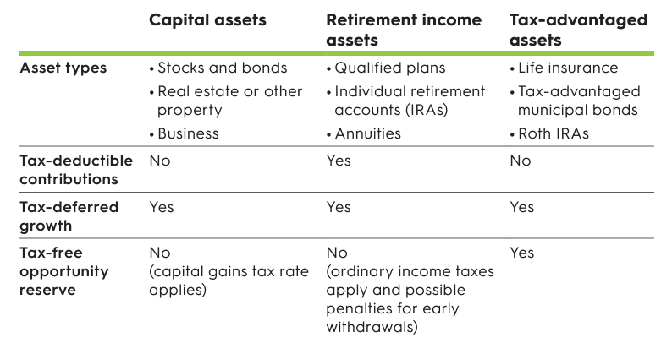
Three types of assets. How are yours taxed?
Notes:
Review chart with audience

Slide 17



How can I pre-fund my retirement taxes?
In addition to your retirement plan, you fund a life insurance policy to help protect your family in case you die.
Notes:
Read slide

Slide 18
How can I pre-fund my retirement taxes?
Should you die during your working years,¹ your beneficiaries will receive the life insurance death benefit income tax free, as well as your remaining qualified plan assets.
1. If owner and insured are different, the death benefit will be paid upon death of the insured.
Notes:
Read slide; including disclosure at bottom

Slide 19
How can I pre-fund my retirement taxes?
In your retirement, for each distribution you receive from your retirement plan, take an amount equal to the tax on that distribution from your insurance policy’s cash value.
Policy cash values may be accessed in a tax-advantaged manner through withdrawals up to the amount you paid in, or loans against the remaining cash value. These can be used to pay the tax on your distributions.
Notes:
Read slide

Slide 20
How can I pre-fund my retirement taxes?
By using the cash value in your policy, you will have effectively paid the tax on your qualified plan distributions. And by buying life insurance now, you can begin funding those tax obligations and take advantage of potential tax-deferred growth in the policy over the years.
Notes:
Read slide

Slide 21

And by buying life insurance now…
Life insurance can be a valuable financial tool that can help you…
Ensure your family is protected
Protect the value of your assets
Provide emergency funds
Provide a tax-advantaged “opportunity reserve”
Pre-fund your retirement taxes and lower your effective tax rate in retirement
Efficiently pass your estate value to loved ones
Notes:
Read slide

Slide 22
Potential benefits
The death benefit to your beneficiaries is income-tax free.
If the life insurance has cash value, you may be able to access those dollars during the insured’s lifetime if you own the policy.
Your heirs can decide when they access the money from the death benefit you left to them; it’s not based on a government table.
Notes:
Read slide.

Slide 23
Potential risks
Income taxes will be due on distribution from the qualified plan.
Distributions prior to age 59½ from a qualified plan may be subject to an additional 10 percent penalty.
The insured must be underwritten for the life insurance you purchase.
Tax rates may change over time and make the strategy less attractive.
Life changes may require you to use plan assets for living expenses, which could put funding of your life insurance policy in jeopardy.
Policy loans and withdrawals may create an adverse tax result in the event of a lapse or policy surrender and will reduce both the surrender value and death benefit.
Notes:
Read slide.

Slide 24
Notes:
This is a good opportunity to take questions from your audience.

Slide 25
Please keep in mind that the primary reason to purchase a life insurance product is the death benefit.
Life insurance products contain charges, such as Cost of Insurance Charge, Cash Extra Charge, and Additional Agreements Charge (which we refer to as mortality charges), and Premium Charge, Monthly Policy Charge, Policy Issue Charge, Transaction Charge, Index Segment Charge, and Surrender Charge (which we refer to as expense charges). These charges may increase over time, and these policies may contain restrictions, such as surrender periods. Policyholders could lose money in these products.
Policy loans and withdrawals may create an adverse tax result in the event of lapse or policy surrender and will reduce both the surrender value and death benefit. Withdrawals may be subject to taxation within the first 15 years of the contract. You should consult your tax advisor when considering taking a policy loan or withdrawal.
The policy design you choose may impact the tax status of your policy. If you pay too much premium, your policy could become a modified endowment contract (MEC). Distributions from a MEC may be taxable, and if the taxpayer is under the age of 59½, may also be subject to an additional 10% penalty tax.
This information is a general discussion of the relevant federal tax laws provided to promote ideas that may benefit a taxpayer. It is not intended for, nor can it be used by any taxpayer for the purpose of avoiding federal tax penalties. Taxpayers should seek the advice of their own advisors regarding any tax and legal issues specific to their situation.
This is a general communication for informational and educational purposes. The information is not designed, or intended, to be applicable to any person’s individual circumstances. It should not be considered investment advice, nor does it constitute a recommendation that anyone engage in (or refrain from) a particular course of action. If you are seeking investment advice or recommendations, please contact your financial professional.
Insurance products are issued by Minnesota Life Insurance Company in all states except New York. In New York, products are issued by Securian Life Insurance Company, a New York authorized insurer. Minnesota Life is not an authorized New York insurer and does not do insurance business in the state of New York. Both companies are headquartered in St. Paul, MN. Product availability and features may vary by state. Each insurer is solely responsible for the financial obligations under the policies or contracts it issues.
Securian Financial is the marketing name for Securian Financial Group, Inc., and its subsidiaries. Minnesota Life Insurance Company and Securian Life Insurance Company are subsidiaries of Securian Financial Group, Inc.
securian.com
400 Robert Street North, St. Paul, MN 55101-2098
©2024 Securian Financial Group, Inc. All rights reserved.
3282500 DOFU 1-2024
Notes:
Presenters, be sure to land on this slide and let it show while you wrap up your remarks.

