Slide 1
Take BOLD action to advance your business
TEMPLATE: THIS SLIDE MAY BE REMOVED BASED ON PRESENTER
<firm contact information>
<firm disclosures>
Life insurance products provided by Minnesota Life Insurance Company | Securian Life Insurance company

Slide 2
Need solutions for complex business challenges?
Notes:
<read slide title?
As a business owner, your first concern is growing your business.
You face tough financial questions, like:

Slide 3
Need solutions for complex business challenges?
?
Do you want to step back from your business one day, or walk away and fully retire?
Notes:
Do you want to step back from your business one day, or walk away and fully retire?

Slide 4
Need solutions for complex business challenges?
?
Will your business suffer if a key person dies or becomes disabled?
Notes:
Will your business suffer if a key person dies or becomes disabled?

Slide 5
Need solutions for complex business challenges?
?
Is most of your personal wealth tied up in the business?
Notes:
Is most of your personal wealth tied up in the business?

Slide 6
Need solutions for complex business challenges?
?
Do your rank-and-file employees have retirement options?
Notes:
Do your rank-and-file employees have retirement options?

Slide 7
Need solutions for complex business challenges?
?
Are your key people happy or do you risk their departure?
Notes:
Are your key people happy or do you risk their departure?

Slide 8
Need solutions for complex business challenges?
?
Who will take over when you no longer wish – or are no longer able – to run the operation?
Notes:
Who will take over when you no longer wish – or are no longer able – to run the operation?

Slide 9
Notes:
These are complex issues. They can cause a business owner to avoid making decisions. They can distract you from your effective management.
Securian Financial offers solutions for business owners. Whether you’re trying to grow your business, retain your key people or navigate your departure from the business, we can help. We’ll show you how you can identify and prioritize your business needs and we’ll work with your tax and legal advisors to develop customized solutions.
The Business Owner Life-stage Design (BOLD) process can help business owners like you. With BOLD, we can help address the unique and complex challenges you face. So you can stay focused on your business – and achieving the goals that matter most to you.

Slide 10
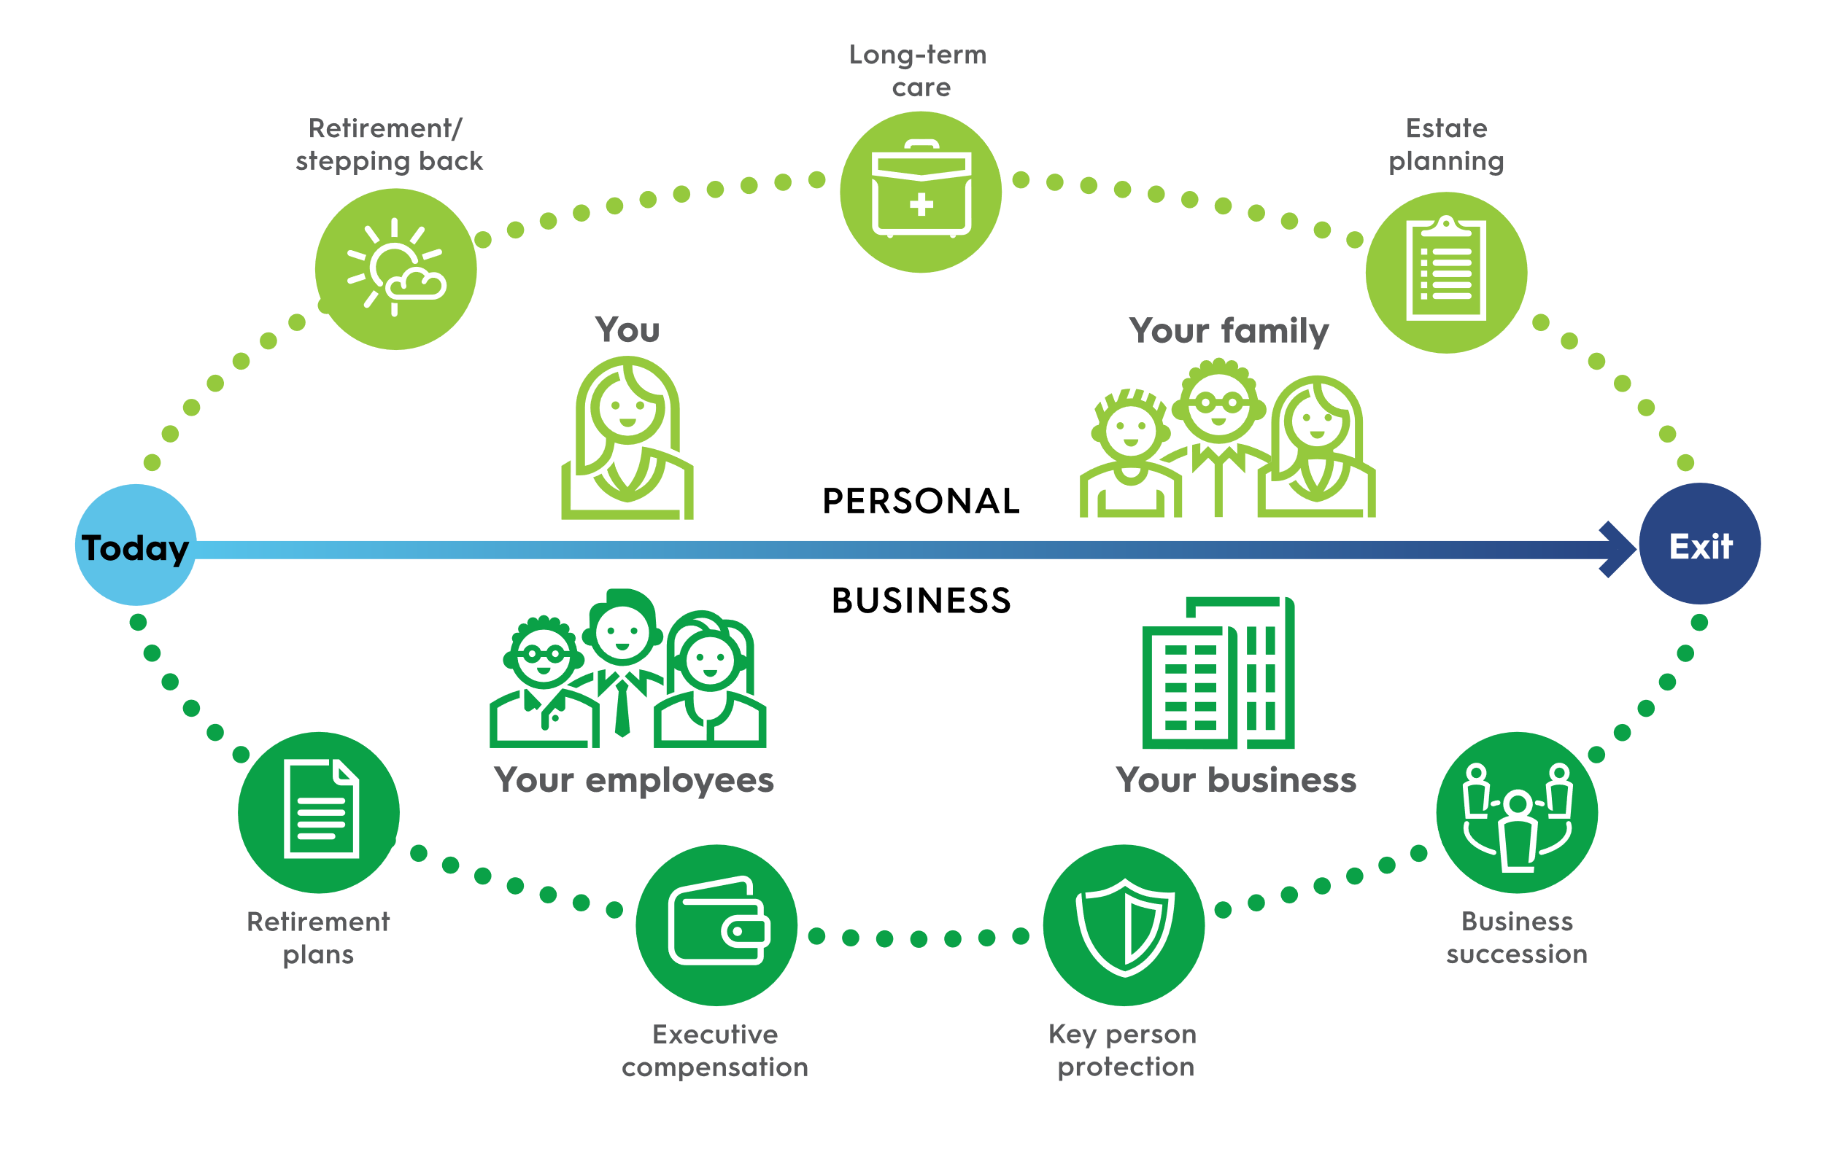
Tell us about your top priorities
Notes:
Have you saved enough to maintain your lifestyle and become independent of the business?
Your retirement strategy should reflect your vision for retirement: will you retire completely, or simply step back from actively managing your business? Limiting the amount of taxes you pay in retirement helps you retire comfortably and pass more wealth on to your heirs.

Slide 11
Tell us about your top priorities
Notes:
What would happen to your business if you developed a chronic illness?
Because of the increasing likelihood you may need care as you age, take steps now to
learn about your options, including life insurance products with provisions to help you
plan for your potential long-term care needs.

Slide 12
Tell us about your top priorities
Notes:
Can you successfully transfer the assets you’ve worked a lifetime to accumulate?
Traditional estate planning focuses on what happens to assets at your death. But estate
planning can also provide the opportunity to focus on assets while you are alive. An
estate plan can maximize how you enjoy life today and in retirement, and also maximize
the assets you pass on to your family.

Slide 13
Tell us about your top priorities
Notes:
Does your qualified retirement plan complement your business objectives?
Your company’s retirement plan can help retain employees and enhance their financial security. It’s crucial that your retirement plan complements your business objectives.

Slide 14
Tell us about your top priorities
Notes:
Have you implemented strategies to recruit, reward and retain
key employees?
Key employees make critical contributions to your company’s profitability. Selective
executive compensation benefits reward those employees most responsible for your
company’s growth and allow key employees to share in business accomplishments.

Slide 15
Tell us about your top priorities
Notes:
If a key person in your organization dies, will your business suffer financially?
The death of a key employee could cause serious problems for your business, such as
lost sales, lower earnings and loss of intellectual capital. The cost of hiring and training a replacement could negatively impact your business. You need a strategy to replace those costs and operate smoothly after losing a key employee.

Slide 16
Tell us about your top priorities
Notes:
Have you taken the steps to turn your hard work and goodwill into cash when you leave the business?
A business succession strategy is a key to the success and survival of your company. Prepared well in advance, strategies such as buy-sell arrangements can successfully transfer a business interest on your terms.

Slide 17
Take BOLD action
Now, let’s get started…

Slide 18
We’re guided by our purpose: helping customers build secure tomorrows. Since 1880, we’ve been building a uniquely diversified company that has outlasted economic ups and downs while staying true to our customers. We’re committed to the markets we serve, providing insurance, investment and retirement solutions that give families the confidence to focus on what’s truly valuable: banking memories with those who matter most.

Slide 19
Please keep in mind that the primary reason to purchase a life insurance product is the death benefit.
Life insurance products contain fees, such as mortality and expense charges (which may increase over time), and may contain restrictions, such as surrender periods.
Other than contribution limits or tax treatment, several other factors should be considered before purchasing any life insurance products. These include investment objectives, costs and expenses, liquidity, safety, fluctuation of principal or return, credit rates, rider availability, surrender periods and other product/ investment characteristics.
This material may contain a general analysis of federal tax issues. It is not intended for, nor can it be used by any taxpayer for the purpose of avoiding federal tax penalties. This information is provided to support the promotion or marketing of ideas that may benefit a taxpayer. Taxpayers should seek the advice of their own tax and legal advisors regarding any tax and legal issues applicable to their specific circumstances.
This is a general communication for informational and educational purposes. The information is not designed, or intended, to be applicable to any person’s individual circumstances. It should not be considered investment advice, nor does it constitute a recommendation that anyone engage in (or refrain from) a particular course of action. If you are seeking investment advice or recommendations, please contact your financial professional.
Insurance products are issued by Minnesota Life Insurance Company in all states except New York. In New York, products are issued by Securian Life Insurance Company, a New York authorized insurer. Minnesota Life is not an authorized New York insurer and does not do insurance business in New York. Both companies are headquartered in St. Paul, MN. Product availability and features may vary by state. Each insurer is solely responsible for
the financial obligations under the policies or contracts it issues.
Securian Financial is the marketing name for Securian Financial Group, Inc., and its subsidiaries. Minnesota Life Insurance Company and Securian Life Insurance Company are subsidiaries of Securian Financial Group, Inc.
Securian Financial Group, Inc.
securian.com
400 Robert Street North, St. Paul, MN 55101-2098
©2022 Securian Financial Group, Inc. All rights reserved.
2571726 DOFU 11-2022

