Slide 1
Exploring your best options
Social Security
Products issued by Minnesota Life Insurance Company/Securian Life Insurance Company
Notes:
Welcome, thank people for coming.

Slide 2
What we’ll cover today
Things to consider before collecting
An intro to Social Security
Claiming strategies
Taking action
Unless otherwise noted, the Social Security statistics and numbers presented are from ssa.gov, and are current as of year end 2025.
Notes:
We will cover a lot of ground today on this topic.
First, we will set the stage with some general observations about risk faced by retirees
Second, we’ll explore the basics of Social Security – what it provides, who is eligible to receive it, and when benefits can begin
Then we’ll move into claiming strategies that you can use to maximize your Social Security benefits
We’ll end with resources you can use to help you explore your options
Many of the concepts in this workshop are described in the Guide to Social Security – Considering your options. This is yours to keep. Feel free to make notes in the booklet throughout the workshop.

Slide 3

Collection considerations
Notes:
With quite a bit of cash at stake, deciding when to claim is a big decision. We will discuss ideas on the things you should consider before collecting. Record your thoughts as we go or just feel free to ask questions along the way.

Slide 4
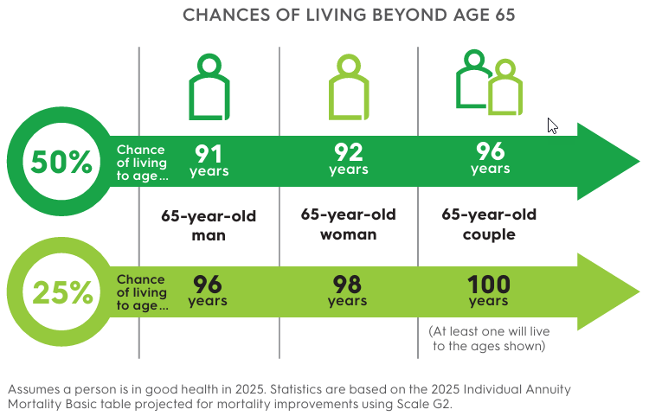
Longevity plays a factor in retirement income planning
Notes:
As we work through the options for electing Social Security, longevity is an important consideration when determining what claiming option is best for you. In other words, how long do you think you will live? Let’s look at some of the averages as shown in this graphic.
Americans are living longer, which is great, but it also means we have to realistically plan income for longer retirements. 25% of women who reach age 65 will live to age 98, 25% of men who reach age 65 will live to age 96. And for a couple who reach age 65, one in four will have one spouse live until age 100.
Do you have longevity in your family? Are you in relatively good health? Take a minute now to jot down things like how long your parents and grandparents each lived, or any notable health concerns you want to factor in to your decision of when to claim benefits.

Slide 5
Working in retirement Early retirement - earnings limit
 | 2025 | 2026
Social Security taxable wage base | $176,100 | $184,500
Maximum earnings for individuals under Full Retirement Age before benefit is reduced. | $24,480/year $1 is withheld from benefits for every $2 over the limit | $65,160/year $1 is withheld from benefits, for every $3 over the limit, until the month FRA is reached
Maximum Social Security benefit for a worker retiring at Full Retirement Age | $4,018 | $4,152
Source: ssa.gov, How Work Affects Your Benefits, Publication No. 05-10069, January 2026.
Notes:
Some people consider working in retirement. Have you thought about working in retirement? It may boost your income, but your Social Security benefit may be subject to income tax. We will touch on this more later.
Please keep in mind that the earnings limit counts only the wages you make from your job or your net earnings if you’re self employed. This includes bonuses, commissions, and vacation pay. What isn’t counted?: Pensions, annuities, investment income, interest, veterans benefits, or other government or military retirement benefits.
Sources:
Taxable Wage Base: https://www.ssa.gov/OACT/COLA/cbb.html Contribution and Benefit Base
Maximum benefit: https://www.ssa.gov/faqs/en/questions/KA-01897.html What is the maximum Social Security retirement benefit payable? | Frequently Asked Questions | SSA
What happens if I work and get Social Security retirement benefits? | Frequently Asked Questions | SSA https://www.ssa.gov/faqs/en/questions/KA-01921.html

Slide 6
Common household sources of retirement income
Social Security | 86%
Personal Savings | 58%
Traditional Pension | 56%
Traditional IRA | 48%
Defined Contribution Plan such as 401(k) | 26%
Annuities | 23%
Roth IRA | 17%
Based on 2,692 retirees. Multiple responses allowed. "Personal savings" refers to savings held outside of workplace or individual qualified plans.
Source: LIMRA 2025 Retirement Investor Behaviors, Attitudes and Financial Situations
Notes:
Finally, the last thing to consider is any other sources of retirement income. If you have retirement savings or a pension you may be able to delay collecting Social Security benefits. If not, delaying may not be possible for you.
Take a minute now to jot down all your sources of retirement income to share with your financial professional. Do you have a pension? 401(k)? Other investments? Could you afford to delay taking Social Security?
It’s also important to think about expenses and where your money will go in retirement. Generally the bigger categories for people tend to be housing, healthcare, food and transportation. But think about your activities and associated costs there (for example travel and other entertainment).

Slide 7

An intro to Social Security
Notes:
For many Americans, Social Security is a primary source of income and for many, it is the only source of income that is both guaranteed for life and with a cost of living component. Let’s learn more about this important retirement income source and why many consider it the cornerstone in building a solid retirement income strategy.

Slide 8
Social Security beginnings
Created in 1935
During the Great Depression
American retirement safety net
Notes:
The Social Security program was created in 1935 during the Great Depression. The idea was to help build an American retirement safety net with current workers paying into the program to support former workers.
Although Social Security provides more than just retirement benefits, for our discussion today we’ll keep our focus on the retirement benefits available under this program.

Slide 9
Social Security today
72.9 million people received benefits from programs administered by the Social Security Administration (SSA) in 2024
6.0 million people were newly awarded Social Security benefits in 2024
55% of adult Social Security beneficiaries in 2024 were women
56 was the average age of disabled-worker beneficiaries in 2024
SSA Fast Facts & Figures about Social Security (September 2025)
Notes:
Go through points on slide
Source: Fast Facts & Figures About Social Security, 2025 – Contents https://www.ssa.gov/policy/docs/chartbooks/fast_facts/2025/index.html

Slide 10
A depended-upon source of income
Think back to the table we looked at on sources of retirement income.
Social Security was the greatest source of retirement income for American retiree households.
Notes:
Remember the table a couple slides ago? For many people Social Security is the largest chunk of what you will have in retirement. Go over information on slide and reiterate the importance of knowing how and when you may begin to collect.

Slide 11
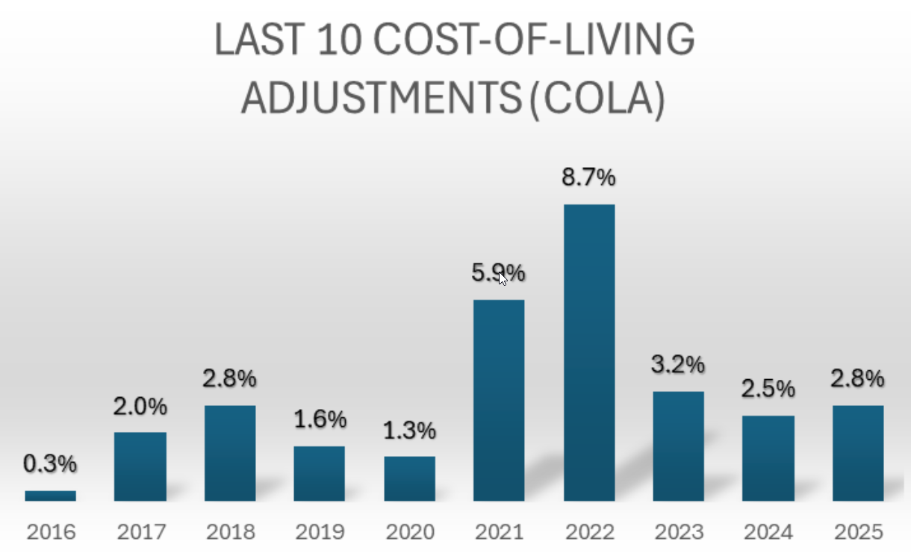
What Social Security retirement benefits provide
Lifetime retirement income
Cost of living adjustments (COLA) for inflation
Spousal and survivor benefits
Social Security Administration, ssa.gov, 2026.
Notes:
So let’s move into what Social Security provides. Social Security provides lifetime, inflation-adjusted income.
A cost of living adjustment is available annually, depending on movement in the Consumer Price Index (CPI). It is announced each October, and is applied to benefits starting January of the next year.
Social Security COLAs typically average 2–3% per year, but can vary widely with inflation—ranging from 0% to nearly 9% in recent years.
Social Security retirement benefits are available not only to workers but are also available to spouses, former spouses, and survivors, providing income for those who may not qualify based on their own work record.
With traditional pension plans on the decline, Social Security is one of the remaining sources of inflation-adjusted income you can’t outlive. That is why it is critical to understand how it works and how your decision on when to claim affects your lifetime benefits.
Source: Cost-Of-Living Adjustments https://www.ssa.gov/OACT/COLA/colaseries.html

Slide 12


How to qualify
40 credits required to qualify
Credits earned during working years
Approximately 10 consecutive years of work
$7,560
$1,890
Earnings needed
per credit
Earnings needed for
4 credits/year
Source: https://www.ssa.gov/benefits/retirement/planner/credits.html
Notes:
To qualify for Social Security retirement benefits, you generally need 40 credits (10 years of work). A credit is earned by working and paying into Social Security. In 2026, you earn 1 credit for every $1,890. 4 credits maximum can be earned per year.
Your benefit amount is based on your highest 35 years of earnings, indexed for inflation. What is indexing for inflation? That means that your past earnings are adjusted (indexed) to reflect today’s wage levels. This prevents older, lower-dollar earnings from unfairly reducing your benefit. If you worked fewer than 35 years, the missing years count as $0- lowering your average.
Indicate we will look at retirement age on the next slides
Source: Retirement Benefits https://www.ssa.gov/pubs/EN-05-10035.pdf

Slide 13
Know the terms
Full retirement age (FRA) – Age at which a person becomes entitled to receive full Social Security retirement benefits.
Between 66 and 67 depending on birth year
Social Security Full Retirement Age
 | 1943 -1954 | 1955 | 1956 | 1957 | 1958 | 1959 | 1960 or later
 | 66 | 66 + 2 mos. | 66 + 4 mos. | 66 + 6 mos. | 66 + 8 mos. | 66 + 10 mos. | 67
https://www.ssa.gov/benefits/retirement/planner/agereduction.html
Notes:
Throughout today’s presentation you will hear a few reoccurring Social Security terms. It is important to know the “Social Security terms” up front so that you don’t miss something later on in the presentation.
The first term is ‘Full Retirement Age’, commonly referred to as ‘FRA’. This is the age at which the Social Security Administration has identified a person becomes eligible to receive full, unreduced benefits.
As you can see in the table, FRA is between 66 and 67 – depending on the year you were born.
Source: Benefits Planner: Retirement | Retirement Age and Benefit Reduction | SSA https://www.ssa.gov/benefits/retirement/planner/agereduction.html
Please fix this chart to make it look

Slide 14

Know the terms
Primary insurance amount (PIA) – The full monthly Social Security benefit you are entitled to receive at FRA.
Determined by your averaged indexed monthly earnings
Notes:
The second term to know is ‘Primary Insurance Amount’, also referred to as ‘PIA’. Your PIA is the full monthly Social Security benefit you are entitled to receive at your Full Retirement Age.
Your PIA is based on a formula that takes into account your average indexed monthly earnings. Simply put, the more you make in your working years, the more you will receive from Social Security.
Source: Primary Insurance Amount https://www.ssa.gov/oact/cola/piaformula.html

Slide 15
Know the terms
Delayed retirement credit (DRC) – increases to your Social Security retirement benefit for every month you delay claiming benefits beyond your Full Retirement Age (FRA), up to age 70. The benefit grows by 8% for each full year of delay, applied in monthly increments, for a maximum of 32%.
Source: https://www.ssa.gov/benefits/retirement/planner/delayret.html
Notes:
The final term we’ll talk about is a ‘Delayed Retirement Credit’ or ‘DRC’.
Delayed retirement credits or DRCs are increases to your Social Security retirement benefit for every month you delay claiming benefits beyond your Full Retirement Age (FRA), up to age 70. The benefit grows by 8% for each full year of delay, applied in monthly increments, for a maximum of 32%.
Source: Benefits Planner: Retirement | Delayed Retirement Credits | SSA https://www.ssa.gov/benefits/retirement/planner/delayret.html and “2026 Retirement Benefits” https://www.ssa.gov/pubs/EN-05-10035.pdf

Slide 16

Claiming strategies
Notes:
We’ve spent some time looking at the basics of Social Security.
Now let’s move onto some Social Security claiming strategies that may apply to you or someone you know. We will look at the basics for married couples, some claiming strategies for them to consider as well as benefits to be aware of for divorced or deceased spouses.

Slide 17
Collecting early
Age 62 is earliest for individual or spousal benefits
Decreases monthly benefit by as much as 30%
Benefits remain reduced – future COLA based on lower benefit amount
Reduces survivor benefits
Potentially more payments at lower amounts
Benefit reduction at age 62
FRA | Monthly reduction
67 | 30%
Source: 2026 Retirement Benefits: https://www.ssa.gov/pubs/EN-05-10035.pdf
Notes:
Qualifying beneficiaries may elect Social Security individual or spousal benefits as early as age 62. However, there is a cost – in the form of reduced benefits – that you pay.
The reduction percentages depend on your Full Retirement Age (FRA). Earlier we discussed the phase in ages. So if your FRA is age 67, the amount of your benefit at age 62 would be 30% less than the amount at age 67.
When you collect benefits early, your benefits remain reduced even after you reach your Full Retirement Age. This lower amount is the basis for potential COLA adjustments and survivor benefits, if any.

Slide 18
Early claiming example
Born: 1964 FRA: 67 Monthly benefit: $2,000
Reduction at 62: 30% Monthly benefit at 62: $1,400
 | EARLY starting at 62 | FRA starting at 67
Monthly benefit | $1,400 | $2,000
By age 70 will collect | $134,400 | $72,000
By age 80 will collect | $302,400 | $312,000
By age 90 will collect | $470,400 | $552,000
Hypothetical example for illustrative purposes only. Does not factor in cost of living adjustments.
Notes:
Here is a hypothetical example of an early route. Here we have an individual born in 1964 with a Full Retirement Age of 67 and a monthly benefit of $2,000. If she collects early at age 62, she will receive a 30% reduction in benefits, resulting in a monthly benefit of $1,400.
The table shows how much she will collect at various ages by either starting early or starting at age 67. As you can see, if she lives past her early 80s she will collect more overall by waiting to collect until FRA.

Slide 19
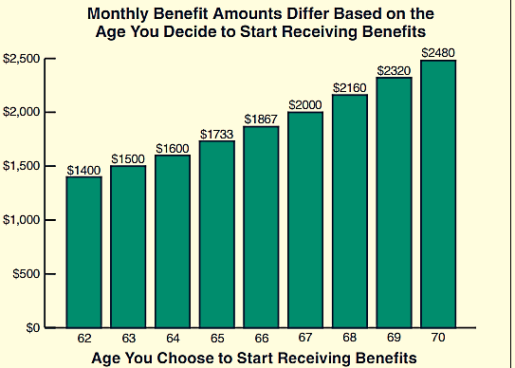
Claiming late
Earns Delayed Retirement Credits
Claiming after FRA earns DRCs
Benefits increase until age 70
Graph assumes a $2,000 benefit at FRA. Example figures from https://www.ssa.gov/pubs/EN-05-10147.pdf This is a hypothetical example for illustrative purposes only.
Age you choose to start receiving benefits
Notes:
Just as claiming benefits before Full Retirement Age decreases your benefits, delayed claiming results in a higher monthly benefit. That’s when Delayed Retirement Credits come into play.
Currently, delaying benefits results in an annual increase of 8 percent.
In the example, a $2,000 monthly benefit at the FRA of 67 has the potential to increase to $2,480 at age 70.
Of course, not everyone can afford to delay claiming benefits. But there are clear advantages, especially when you consider people are living longer. When you delay, claiming future increases for inflation are also based on the higher benefit.
Source: When to Start Receiving Retirement Benefits https://www.ssa.gov/pubs/EN-05-10147.pdf

Slide 20
Delayed claiming example
Born: 1960 FRA: 67 Monthly benefit: $2,000
DRC: 8% Monthly benefit at 70: $2,480
 | FRA starting at 67 | LATER starting at 70
Monthly benefit | $2,000 | $2,480
By age 70 will collect | $72,000 | $0
By age 80 will collect | $312,000 | $297,600
By age 90 will collect | $552,000 | $595,200
Hypothetical example for illustrative purposes only. Does not factor in cost of living adjustments.
Notes:
Here is a hypothetical example of a later route. Once again we have an individual born in 1960 with a Full Retirement Age of 67 and a monthly benefit amount of $2,000. She is eligible for a Delayed Retirement Credit of 8%, so by waiting to start until age 70 she will have received 36 months of Delayed Retirement Credits (8% per year, 24% increase) and will have a monthly benefit amount of $2,480.
The table compares how much she would have received at her Full Retirement Age, versus waiting to claim her maximum benefit at age 70. If she lives past her early 90s she will collect more by starting at age 70.

Slide 21
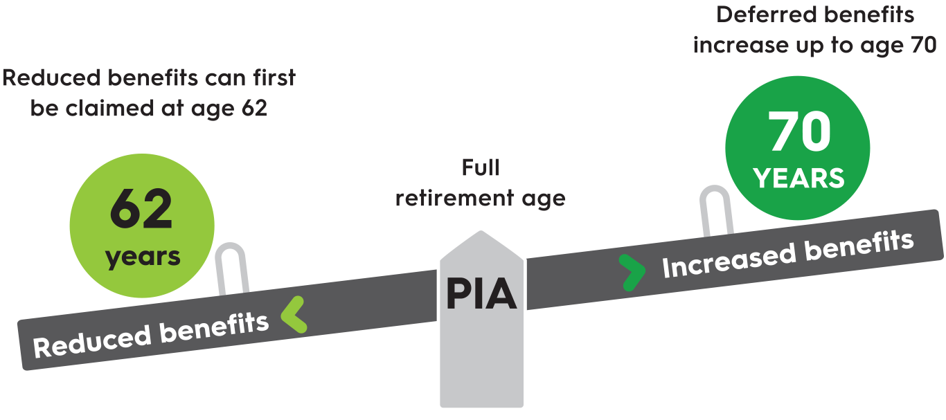
The trade off
How much can you expect? For a quick estimate of your benefit at Full Retirement Age, access your benefit statement online at ssa.gov (you’ll need to set up your account initially) or call the Social Security Administration at 1-800-772-1213.
Notes:
Let’s pause for a quick recap. For many of us, the concepts of FRA, PIA and DRC can be a bit challenging to remember. This picture is a simple way to cement in the effect of choosing to delay electing benefits.
Remember, your Primary Insurance Amount is the amount you are entitled to at your Full Retirement Age. This is based upon qualifying quarters of working and your earned income over your lifetime.
If you choose to take early benefits, you permanently lock in reduced benefits by as much as 30%. If you choose to delay taking benefits to your Full Retirement Age, you will receive your full, unreduced benefit. You can further increase your Social Security benefit by electing to defer up to age 70, where Delayed Retirement Credits come into play to increase the amount of your benefit payments.

Slide 22

Impact of working
If collecting benefits prior to FRA
Some benefits may be withheld
Income limit changes each year
Notes:
It is good to know the impact of earning income when deciding when to collect your benefits.
If you choose to collect benefits early, prior to your Full Retirement Age, your benefits will be reduced by income you earn above an amount that is set each year. The amount of the reduction is $1 of benefits withheld for every $2 in earnings above the limit.
If you start benefits the calendar year that you turn your Full Retirement Age, $1 in benefits will be deducted for every $3 you earn above a higher limit. In 2026, this limit is $65,160. Only earnings up to the month before you reach your Full Retirement Age are counted, not your earnings for the entire year.
If you earn income after Full Retirement Age, your benefit payments won’t be reduced. But something to keep in mind is the impact of taxes on your benefits, which we’ll cover next.
Source: Benefits Planner: Retirement | Receiving Benefits While Working | SSA https://www.ssa.gov/benefits/retirement/planner/whileworking.html

Slide 23
Tax considerations Will I have to pay taxes on my Social Security benefits?
Combined income | Tax filing status | Percent of benefits taxed
Less than $25,000 | Individual | 0%
$25,000 - $34,000 | Individual | 50%
More than $34,000 | Individual | 85%
Less than $32,000 | Married filing jointly | 0%
$32,000 - $44,000 | Married filing jointly | 50%
More than $44,000 | Married filing jointly | 85%
Source: ssa.gov Retirement Benefits Booklet, page 11, Publication No. 05-10035, 1/2026 https://www.ssa.gov/pubs/EN-05-10035.pdf
Notes:
Social Security benefits may be taxed, but it all depends on the amount of other income you receive in a year.
About 40% of people who receive Social Security must pay income taxes on their benefits. Taxable benefits are determined by a formula that adds your Adjusted Gross Income, tax-exempt interest income, and one-half of your annual Social Security benefits. If you are married filing jointly half of your spouse’s annual Social Security benefits are added to that total, also. Depending on the total, you may pay tax on up to 85% of your Social Security benefits.
At the end of each year, Social Security will mail you a Social Security Benefit Statement (Form SSA-1099) that shows the amount of benefits you received.
If you receive Social Security benefits, you can choose to have taxes withheld from your Social Security payment, and Social Security will credit them toward your federal taxes, but you are not required to have federal taxes withheld.
Source: Must I pay taxes on Social Security benefits? | Frequently Asked Questions | SSA https://www.ssa.gov/faqs/en/questions/KA-02471.html
Source: Taxation of benefits https://www.ssa.gov/OACT/ProgData/taxbenefits.html
Source: Request to withhold taxes | SSA https://www.ssa.gov/manage-benefits/request-withhold-taxes
Source: Retirement Benefits https://www.ssa.gov/pubs/EN-05-10035.pdf (page 11 & 12)

Slide 24
Strategies for spouses
Married people are covered
They can claim a spousal benefit whether or not they earned benefits themselves
A spousal benefit is up to 50% of spouse’s PIA
A spouse can claim spousal benefits if these conditions are met:
62 years old or older
Married for at least one year
Spouse has filed for benefits
Source: ssa.gov, Retirement Benefits booklet, page 6: Retirement Benefits https://www.ssa.gov/pubs/EN-05-10035.pdf
Notes:
If you are married, you need not be eligible for individual benefits to claim a spousal benefit. A spousal benefit is up to 50% of your spouse’s PIA. So, if you don’t have a work history to qualify for Social Security yourself, you can still get benefits this way. Or if you have a work history but your spouse’s benefit is double or more what you are entitled to, you may receive more by claiming a spousal benefit in addition to your own benefit.
Source: Who can get Family benefits | SSA https://www.ssa.gov/family/eligibility
Source: https://www.ssa.gov/OACT/quickcalc/spouse.html
Source: Retirement Benefits https://www.ssa.gov/pubs/EN-05-10035.pdf

Slide 25
Strategies for divorced spouses
If you are divorced you can claim a spousal benefit on your ex-spouse’s earnings if …
Your marriage lasted 10 years or more
You (the claimant) have not remarried
You (the claimant) are not entitled to a higher individual benefit
Both you and your ex-spouse are age 62 or older and
Your former spouse has already filed for benefits OR
You have been divorced for at least two years regardless of whether or not your former spouse has filed for benefits
Notes:
Not everybody knows that spousal benefits are available to former spouses as well. These benefits apply even if your former spouse has remarried. Why does this matter? If your former spouse earned substantially higher benefits than your own, you may be entitled to apply for the spousal benefit, which is 50% of your ex-spouse’s benefit.
If you are divorced, you can claim a spousal benefit if…
[review points on slide]
Source: Retirement Benefits page 8 & 9, https://www.ssa.gov/pubs/EN-05-10035.pdf

Slide 26
Strategies for widows and widowers
Widow/widower
Full benefits at FRA, reduced benefits starting at age 60
Can receive as early as age 50 if disabled (before or within 7 years of death)
Special rule for surviving spouse with minor children
Eligible for benefits at any age if not remarried, AND caring for a child under 16 or disabled
Divorced widow(er), if not remarried
If marriage last 10 years or more, they can get same benefits as a widow(er)
Benefits paid do not affect amounts to other survivors
Source: Social Security Administration- https://www.ssa.gov/benefits/survivors/onyourown.html
Notes:
Read points on slide
Spouses and ex-spouses
You may be eligible if you:
Are age 60 or older, or age 50–59 if you have a disability, and
Were married for at least 9 months before your spouse's death, and
Didn’t remarry before age 60 (age 50 if you have a disability).
Ex-spouses who were married for at least 10 years, as well as some valid non-marital legal relationships, may be eligible.
You might be eligible regardless of age and how long you were married. One common example is if you’re caring for a child of the person who died.
•Survivor benefit amount is based on the earnings and number of credits of the deceased worker depending on when they died
•If survivor qualifies for benefits on own earnings record, may switch from survivor to own retirement benefit
You can receive benefits at any age, as a widow, if you are taking care of a child younger than 16 or disabled.
Source: https://www.ssa.gov/survivor and https://www.ssa.gov/survivor/eligibility
From submission #4277121
(*Source: https://www.ssa.gov/benefits/survivors/onyourown.html)

Slide 27
Restricted application claiming strategy
Survivor cannot accrue delayed retirement credit based on their own FRA for the survivor benefits BUT…
If deceased spouse had been delaying, survivor receives that higher benefit
Also, survivor can delay their OWN benefit while taking survivor benefit called restricted filing
For example:
Wife can draw surviving spouse benefits at age 60, and then switch to her own record at age 67 (FRA) or age 70, or
Wife can start her benefit at age 62, and switch to surviving spouse benefit at age 67
Notes:
Restrict your claim for SS retirement benefits to spousal benefits only
Read slide.

Slide 28

Unique circumstances

Slide 29
Considerations for the self-employed
How does self-employment change the Social Security landscape?
Required to pay in both as an employer and an employee
Combined with the Medicare portion, self-employed individuals pay in at a combined rate of 15.3%.
Individual is eligible to receive full Social Security benefits for any month in which the self-employed individual is “retired” as defined by the Social Security Administration.
Notes:
If you are self-employed, you can receive full benefits for any month in which the SSA deems you retired. This is a TWO part test:
There must not be earned income over the income limit: AND
You must not have performed what SSA considers “substantial services”
Remember, this really only applies to people who would be claiming Social Security benefits prior to their Full Retirement Age.
Source: Social Security Administration: “If you are Self-Employed” - https://www.ssa.gov/pubs/EN-05-10022.pdf

Slide 30
Substantial services test
Work less than 15 hours, not considered to have performed substantial services (worker is considered retired)
Work between 15 and 45 hours and the work is considered “highly skilled,” then considered to perform “substantial services”
Work more than 45 hours during the month, generally considered performing “substantial services”
Notes:
Review bullet points.
Source: https://secure.ssa.gov/poms.nsf/lnx/0302505065
Source: https://www.ssa.gov/OP_Home/handbook/handbook.18/handbook-1807.html

Slide 31
Factors used when considering substantial services
The SSA will consider the following
Amount of time the individual devoted to the business
Nature of the services performed (before and after retirement)
Type of business involved
Presence or absence of an adequately qualified paid manager, partner, or family member who manages the business, AND
Amount of capital invested in the business
Notes:
Review bullets on slide

Slide 32
Factors used when considering substantial services, continued.
You maintain ownership of the business
Other family members are involved in the business and a relative is assuming most of your previous duties
You continue to work for the business for lower pay
Do you control the amount you work and how much you are paid, such that you could manipulate either one, or
Your relatives now receive the salary that you previously earned
May ask for business payroll and personnel records, personal and business tax returns, stock transfer agreements and business expense records.
Notes:
Social Security may require some extra information from you to prove you are not earning too much income or performing substantial services. The agency will want to see evidence that you are really giving up full-time work and not merely shifting your pay to someone else. Social Security is likely to ask for information regarding your continuing involvement with your own business if:
REVIEW POINTS ON SLIDE
If SSA comes to the conclusion that you provided services to the business with a value that exceeds the amount you are compensated (based on the time spent, the level of responsibility, and the value of services provided) SSA is then allowed to assign monetary value (compensation) to those services. If this value, in addition to actual compensation, is greater than the amount of earned income permitted for your age, the Social Security benefit may be reduced

Slide 33

The future of Social Security

Slide 34
Social Security tomorrow
It’s a changing landscape
Demographics have caused a concern. The baby boom generation is producing, on average, 10,000 individuals per day turning 65¹
Current projections have the Social Security Trust Fund depleted in 2033 and after that scheduled tax income is projected to be sufficient to pay, 77% of scheduled benefits²
Life expectancy continues to increase
https://www.hhs.gov/aging/index.html
https://www.ssa.gov/oact/TRSUM/
Notes:
Discuss info on slide

Slide 35



Take action today for a secure tomorrow

Slide 36
Stay educated
Visit ssa.gov for benefit and program info
Create an account to view your earnings and estimated retirement benefits
Access a benefits application form
Find an office near you
Notes:
One of the best things you can do is stay up on current news and educate yourself as much as possible. SSA.GOV is trustworthy place to get information.

Slide 37
Work with a financial professional
Social Security is an important source of retirement income
Many options and additional strategies for collecting benefits
Your story and circumstances are unique to you
We can prepare a simple or comprehensive estimate for you
Notes:
The good news is that by attending today’s presentation you have taken an important first step in developing your Social Security strategy. Deciding when and how to collect your benefits is a huge decision. So it is important to have a financial professional to help you navigate things. You can use today’s workbook as a reference tool for when you work with your financial professional.
Everyone’s retirement journey is unique, so it is important to have access to planning tools that can take many factors into account. We have access to various calculators, that can help prepare a simple or comprehensive Social Security estimate for you.

Slide 38
This information is a general discussion of the relevant federal tax laws provided to promote ideas that may benefit a taxpayer. It is not intended for, nor can it be used by any taxpayer for the purpose of avoiding federal tax penalties. Taxpayers should seek the advice of their own advisors regarding any tax and legal issues specific to their situation.
This is a general communication for informational and educational purposes. The information is not designed, or intended, to be applicable to any person’s individual circumstances. It should not be considered investment advice, nor does it constitute a recommendation that anyone engage in (or refrain from) a particular course of action. If you are seeking investment advice or recommendations, please contact your financial professional.
Insurance products are issued by Minnesota Life Insurance Company or Securian Life Insurance Company, a New York authorized insurer. Minnesota Life is not an authorized New York insurer and does not do insurance business in New York. Both companies are headquartered in St. Paul, MN. Product availability and features may vary by state. Each insurer is solely responsible for the financial obligations under the policies or contracts it issues. Securities and investment advisory services offered through Securian Financial Services, Inc., member FINRA, 400 Robert Street North, St. Paul, MN 55101-2098,1-800-820-4205.
Securian Financial is the marketing name for Securian Financial Group, Inc., and its subsidiaries. Minnesota Life Insurance Company and Securian Life Insurance Company are subsidiaries of Securian Financial Group, Inc.
Securian Financial Group, Inc. securian.com
400 Robert Street North, St. Paul, MN 55101-2098 ©2019-2026 Securian Financial Group, Inc. All rights reserved.
F80607-6 DOFU 4-2026 5364493

