Slide 1
Preparing financially for college
Presenter name
Designations
Firm name
Click to add date
Notes:
[PRESENTER: Insert your name and firm name( before presenting. NOTE: If appropriate, speak with your field principal for correct disclosure.]
Hello and welcome to today’s workshop. I’m <NAME> with <FIRM NAME>.
Today, we’ll discuss preparing for higher education opportunities, from a financial perspective. We’ll focus a lot of our conversation on college, the associated costs and some thoughts on how to prepare for those costs.
<INSERT brief presenter background/opener: Years of experience, financial expertise, etc.>

Slide 2

Corresponding workbook
Important concepts in your workbook
Make notes on actions you’d like to take
Notes:
You have been provided with a workbook to aid with today’s conversation.
Important concepts are highlighted in your workbook
Feel free to take notes in your workbook to identify actions you’d like to take as a result of what you learn today.
At the end of this session, you’ll have the opportunity to complete an evaluation. This helps us to continually improve the information that we bring to you.

Slide 3


Group discussion
What do you hope to learn at today’s session?
Page 2
Notes:
GROUP DISCUSSION
[Financial Professional: Make this an interactive part of the presentation. ]
I invite you to make today’s session interactive … let’s start now by talking about what you’re hoping to learn.
What do you hope to learn at today’s session?
Is anyone comfortable sharing an example of a specific college funding challenge? Chances are, someone else has the very same question.
[Financial Professional: If there’s a white board or easel paper in the room, write out questions/challenges and make sure you address during the session. If a more complex answer is required, invite attendee(s) to setup an appointment or a phone call with you.]

Slide 4

Higher education today
Notes:
There was a time when young people could just work a summer job and earn enough money to pay for college, or other forms of higher education. Unfortunately, those days are likely over.
Let’s start by taking a look at higher education today.

Slide 5

What is higher education?
    College or university
      Online
      On campus
    Community college
    Vocational and technical school
Notes:
Higher education is simply education beyond high school. It includes a wide range of institutions, such as colleges and universities (whether online degrees or attending courses in person), community colleges, and vocational and technical schools.

Slide 6
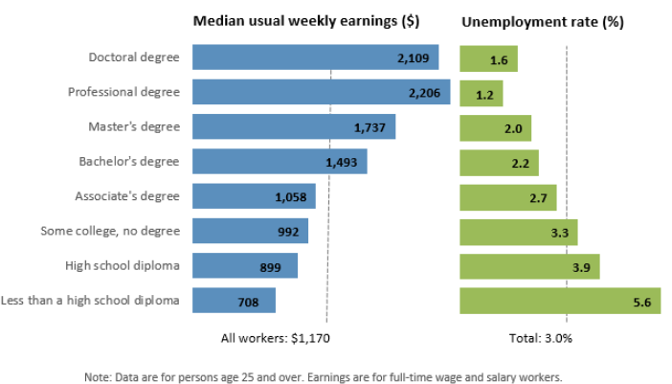
Why consider higher education?
Earnings and unemployment rates by educational attainment
Source: Unemployment rates and earnings by educational attainment. U.S. Bureau of Labor Statistics. https://www.bls.gov/emp/tables/unemployment-earnings-education.htm, last modified August, 2024.
Page 3
Notes:
There is a direct connection between the level of education, employment and income.
This chart from the Bureau of Labor Statistics shows two important connections. On the right, in green, we can see the unemployment rates based on the level of education attained. Those with less than a high school diploma have the highest unemployment rate; those who attained a doctoral degree show the lowest unemployment rate. The rate of unemployment was 1.6% at the top of the educational scale and highest for those with more than a high school diploma. Based on these Dept of Labor stats, there appears to be a correlation between level of education and unemployment rate.
There is also a correlation between the employment income and level of education. Those with doctoral or professional degrees earn significantly more than those with an associate’s degree or less.
Now we all probably can think of someone who is an exception to the rule. Perhaps someone who is a high school graduate who became a dot-com billionaire or someone who achieved a masters degree and decided to become a surfer. Those are exceptions, not the rule. In today’s economy, higher education and even lifelong education is generally the standard for achieving financial security.

Slide 7
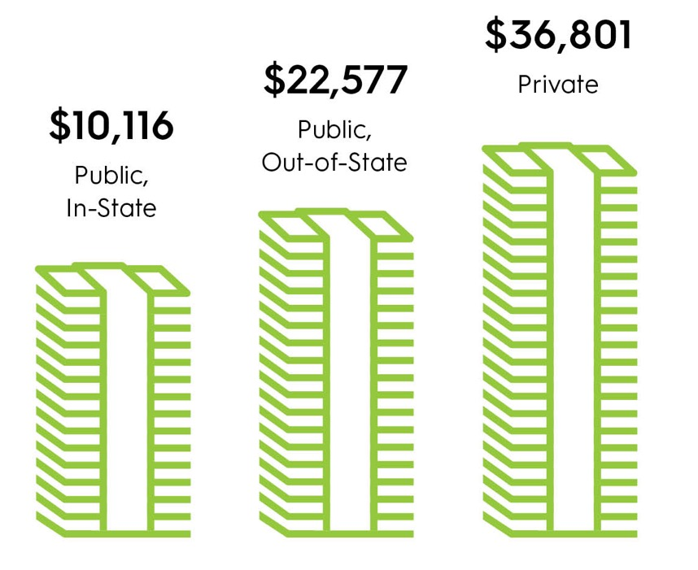
Average annual cost
2024 - 2025 tuition and fees
$43,350
$30,780
Private
$11,610
Public,
out-of-state
Public,
in-state
Source: “Trends in College Pricing: Highlights 2024, College Board https://research.collegeboard.org/trends/college-pricing/highlights#:~:text=Published%20or%20Sticker%20Prices,%25%20before%20adjusting%20for%20inflation).
Notes:
Let’s take a look specifically at obtaining a college education. What does it typically cost?
Where you choose to go to school can make a big difference in the cost of higher education.
The average cost of college varies depending on the type of school, whether the student is in or out of state and also what the living and meal plans end up being. But we all know the costs have continued to rise.

Slide 8
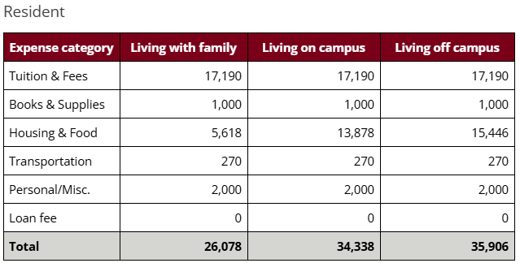
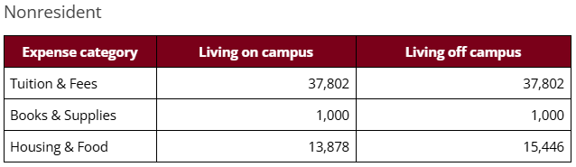
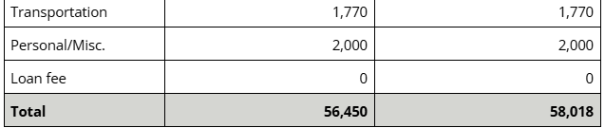
Breaking it down
Cost of attendance
Example: University of Minnesota
Source: University of Minnesota, Twin Cities. https://docs.google.com/document/d/1sSgOJxxAvnEJqHczvekge-KZHTOqofzkfySj1YLilCk/edit?pli=1&tab=t.0
Page 4
Notes:
We’ve looked at tuition & fee cost increases but as any parent of a college student will tell you, that’s only a portion of the total cost. Most schools will provide a similar table like this. This one happens to be from the University of Minnesota in the Twin Cities which is the larges university in Minnesota.
Breaking fees down like this will give you a much better picture of the total cost of attendance per year. And as you can see there is often a dramatic different between resident and nonresident
Tuition and fees
Room and board
Books and supplies
Personal expenses and transportation
It can be daunting to consider this when weighing the cost and benefit of higher education.
Source: University of Minnesota, Twin Cities, https://docs.google.com/document/d/1sSgOJxxAvnEJqHczvekge-KZHTOqofzkfySj1YLilCk/edit?pli=1&tab=t.0

Slide 9
How families pay
Parent income & Savings
Scholarships and grants
Student loans
Parent loans
Student income and savings
Other
37%
27%
12%
11%
11%
2%
Source: How America Pays for College 2024, Sallie Mae’s national study of college students and parents. https://www.salliemae.com/about/leading-research/how-america-pays-for-college/
Page 4
Notes:
With increasing expenses, it’s easy to become overwhelmed. Let’s look at how families pay for college today. According to information provided by Sallie Mae
<Share percentages in slide>
While these are based on averages, you can see that paying for college is a combination effort. Few families are in the position of writing a check for all expenses.

Slide 10
Group discussion
Any observations?
What reactions do you have to cost?
©2023 Securian Financial Group. All rights reserved.
Notes:
GROUP DISCUSSION
[financial professional: Make this an interactive part of the presentation. Does anyone have any observations? Any reactions to the cost of higher education?
On page 3 of the workbook, jot down the names of any future college students that you want to keep in mind. Include their age and the number of years until they turn 18 so that you can come back to this when considering strategies to pay for their future education.
[financial professional: If there’s a white board or easel paper in the room, write out questions/challenges and make sure you address during the session. If a more complex answer is required, invite attendee(s) to setup an appointment or a phone call with you.]

Slide 11

College funding options
Notes:
We’ve established that higher education can be expensive. Now let’s turn to how people can pay for it.

Slide 12
Ways to reduce college costs
• Begin saving early
• Financial aid
• Apply for scholarships and grants
• College loans
• Earn college credits in high school
• Attend community college first
• Compare housing options and transportation costs
Page 5
Notes:
How can you prepare for and reduce college costs? When looking at the total picture, there are some things you can consider.
Perhaps the simplest and most obvious way is to start saving for college early. Creating a cushion for those burgeoning costs can help you cover the costs when the time comes.
Financial aid award packages can go a long way toward reducing tuition and fees for families with a financial need. Families may qualify for Federal financial aid, or a college may have options they can offer.
Grants & scholarships are typically a cash award that directly offsets the cost of higher education. They may be available with or without regard to financial need. Merit based grants can be awarded for academic, athletic, artistic or special-interests. Search engines exist to help your student to identify potential scholarships and grants.
College loans are often available and, though the cost is just deferred, it may be worth considering in helping reduce immediate costs.
For those of you with students in high school, it’s a good idea to connect with an academic advisor as they can help in identifying sources to offset the cost of college for your student. But, they can also provide information about how high schools students can earn college credits while still in high school. In fact, there may be high school programs available for trade schools as well.
Similarly, 2-year community colleges are often less expensive that 4-year colleges and universities. A student could take courses at a community college then transfer to finish a degree, in order to save money.
When choosing a school, consider and compare housing options and transportation costs. Is it cheaper to stay at home and commute? Live on-campus? Off-campus? Online classes? These days, there are many options that can help save money.
Used as a reference for notes: Seven ways to reduce college costs, Forbes. https://www.forbes.com/sites/rcarson/2019/09/22/7-ways-to-reduce-college-costs/?sh=153d48d25e77 as of 2/16/2023

Slide 13
Start saving early
Investment = $12,480
$79,400
Early starter
Invested for 10 years, then stopped
$91,880
Late starter
Waited 10 years to start,
then invested for 20 years
$60,457
Investment = $24,960
$35,497
10 years
30 years
Investment period
Investment gain
Assumes weekly contribution of $24 and 8 percent annual return compounded quarterly. This chart is hypothetical and for illustrative purposes only. It is not indicative of any particular investment. Investments will fluctuate and when redeemed may be worth more or less than when originally invested.
Notes:
If you have the ability, start saving for college costs early. Whether you’re saving for yourself, a child or a grandchild, a friend or relative, beginning the journey allows you to take advantage of compound interest or other investment vehicles.
Compound interest refers to the phenomenon whereby the interest associated with a bank account, loan, or investment increases exponentially—rather than linearly—over time. The more time you have, the more you benefit you can realize from compounding interest.
When your starting amount is higher, your increases are higher too. And over time, it can seriously add up. Let’s take the example of The Early Starter vs. the Late Starter.
This example compares an “Early Starter” who invests $24 a week for 10 years, then stops. On the other hand, our “Late Starter” doesn’t get around to investing for the first 10 years but invests longer at $24 a week for 20 years. With both examples, we’ll assume an 8 percent annual return, compounded quarterly. At the end of our time horizon, the Early Starter had $91,880 while the Late Starter only has $60,457.
Even though our Early Starter stopped investing after just 10 years, the example shows how time and compound interest gives her an advantage over the Late Starter who invested the same amount for 20 years. Our Late Starter has less time for his account to grow. This is the power of compounding interest.
Later in this presentation, we’ll cover some tax-advantaged savings vehicles you can consider when saving for college.

Slide 14

Free application for
Federal Student Aid (FAFSA)
    Apply for aid at FAFSA.gov
    FAFSA has undergone changes and there have been complications and delays
    Complete each year even if you don’t think you will qualify for federal aid
    The form usually becomes available sometime in the fall for the upcoming year
    Visit studentaid.gov for information
Pages 5-6
Notes:
So how do you know if you qualify for federal student aid? The first place to begin is filling out the the Free Application for Federal Student Aid, knows as the FAFSA form. This is managed by the office of the U.S. Department of Education. Typically, this is the starting place for undergraduate and graduate students to determine eligibility for student financial aid. The FAFSA has undergone changes to try and simplify it but this has caused some complications and delays which will hopefully be resolved as time goes on. The estimated release for the 2025-2026 FAFSA is December 1, 2024.
Students may complete this online application as soon as the form becomes available for the upcoming year. The process includes student and family information, including family income, tax filings and investment information. The FAFSA must be filled out every year for the upcoming academic year. Even if you think you won’t qualify for federal aid, you should still complete the FAFSA as most schools use this information to release additional scholarships and financial aid.
The application also asks students to identify potential schools so keep that in mind when completing this form.
When the process is completed, FAFSA will communicate an “Expected Family Contribution”. This is the amount that the student may be expected to pay after all Federal programs are considered.

Slide 15
Prepare for FAFSA
    Student information
      Assets and income
      Social Security number and driver’s license
    Family assets and income
    Questions about special circumstances
      Military service
      Disability
Have ready
    W-2 forms
    1099 forms
    Tax returns
    Bank, brokerage and investment statements
Notes:
The FAFSA requires information on the student and family. Some of the information required includes assets & income, Social Security number and driver's license.
You will want to have some records ready such as W-2 forms, 1099’s, tax returns as well as bank, brokerage and investment account statements.
But just because a family’s income is too high for federal financial aid doesn’t mean they won’t qualify for any type of financial aid. Colleges and universities have their own eligibility requirements for grants, scholarships and work study jobs.

Slide 16
Apply for additional scholarships and financial aid
    Check with the school’s financial aid office as most have college specific scholarships students can apply for
    Work with high school counseling office if you have one
    Check with employers, churches and any other organizations you might be affiliated with to see if they have scholarships available.
    Multiple other online resources such as The National Scholarship Providers Association (NSPA)
    Turn over all the rocks!
Pages 5-6
Notes:
Scholarships and grants can bring significant financial relief to families looking for ways to shrink their college funding gaps. Taking the time to learn about and apply for scholarships can help reduce the financial burdens of school and graduate with less debt.
It can be a lot of work to fill out all of the applications, but turning over every scholarship rock is an important piece of the financial puzzle to pay for college.

Slide 17

Education loans
Loans to pay for education are the norm
    Federal student loans
      Direct unsubsidized
      Direct subsidized
    Direct PLUS loans
    Private loans
For most students, taking out some loans is now the norm
Learn more about student loans
studentaid.gov
Notes:
For most students today, taking out a loan to pay for college is the norm. The federal government has several types of loans available. You must file an annual FAFSA to be eligible for any of the federally funded loan programs.
PLUS loans are another type of federally funded loan. They can be taken out by parents to pay for the remaining cost of college for their child.
Many students and their parents take out private loans to pay for college expenses. While this is a viable option, be very careful and do your research.

Slide 18
Tuition discounts
Complete the school’s net price calculator.
Many schools will offer tuition discounts for good grades, high test scores or other circumstances that can lower the “base sticker price”
Notes:
Many private, and some public, institutions offer discounts on tuition. It is worthwhile to think of tuition as a “base sticker price”.
Depending on the individual student circumstances, tuition and fees can be significantly reduced.
Fill out the financial aid calculator found on a school’s website if you are considering their program. School calculators are a good place to start and can give you an idea what the cost at that school would be for your child.

Slide 19
Timeline
Visit schools
FAFSA
Prep tests
Identify schools
Apply to schools
Page 6
Notes:
For many high school students, the planning process for higher education begins long before graduation. Many students take preliminary ACT / SAT tests early in their high school years. The final scores go on college applications and can determine eligibility to apply.
Students and their families also begin to identify schools to consider. Visiting campus is often recommended and a way to measure the non-academic aspects such as walkability, culture and fit for the particular student.
The FAFSA process opens in the fall and that’s when many seniors begin to nail down their preferred schools.
Students apply to their selected schools, which sometimes require an application fee. Many schools offer early acceptance so if your student has a preferred choice, it may make sense to apply early.

Slide 20
Group discussion
Any thoughts on paying for education?
Any surprises?
©2023 Securian Financial Group. All rights reserved.
Notes:
GROUP DISCUSSION
[financial professional: Make this an interactive part of the presentation. Ask attendees if they have any observations or surprises that they would be willing to share?
[financial professional: If there’s a white board or easel paper in the room, write out questions/challenges and make sure you address during the session. If a more complex answer is required, invite attendee(s) to setup an appointment or a phone call with you.]

Slide 21

Developing a strategy
Notes:
We have covered the connection between education and income, the cost of college today and ways to pay for higher education.
Preparing for the cost of higher education is difficult for many families. With housing costs on the rise, costs associated with raising children and everyday living expenses, it’s hard to prepare.
Let’s turn to strategies for you and your family to consider for higher education.

Slide 22
Things to avoid
Taking out a second mortgage
Pausing retirement investments
Investing aggressively
Notes:
As you consider ways to pay for college, there are some strategies to avoid.
It may be tempting to make up for lost time by investing aggressively. This can be a big mistake as this strategy can result in big losses just when your student needs the money. Consider your time horizon, risk tolerance and invest accordingly.
Taking out a second mortgage on your primary residence is generally not a good idea. By doing so, you put your personal residence at risk in the event that you cannot make payments in the future.
While family finances are often tight during this phase of life, it can be a mistake to stop funding your own retirement. Retirement assets are not included for FAFSA funding purposes so continue to save for your own future.

Slide 23
Develop a college funding strategy
Budget for higher education
Put time on your side!
Invite family members to invest for the future
Notes:
For many parents and grandparents, the desire to fund higher education is a priority. And, for some, paying off student debt is more than a memory- student debt may still be part of the family budget. But the goal is the next generation - Setting kids up for the future they want.
By identifying goals and budgeting for higher education, families can prepare for future education expenses.
Developing a strategy for education as early as possible allows you to put time on your side. Developing a strategy can mean setting money aside in a savings account or using financial tools that have been specifically designed to help fund future education expenses. The earlier you identify a strategy and begin putting money towards it, the better. Investing regularly allows your gains and interest to compound and potentially grow.
Many families share their plans with grandparents, aunts, uncles, godparents or other involved friends. By inviting family members to contribute for the future in lieu of purchasing quickly-forgotten gifts, a college funding strategy can meet it’s goals. And many people can feel like they’re part of an exciting future.

Slide 24
What are some funding options?
    • 529 college savings plan
    • Coverdell Education Savings Account (ESA)
    • Roth IRA
    • Uniform Transfers to Minors Act (UTMA) and Uniform Gifts to Minors Act (UGMA)
    • Cash value life insurance policy
    • Mutual funds, stocks, bonds
    • Bank accounts and Certificate of Deposits (CDs)
Page 7

Slide 25
529 plans
Benefits
Considerations
Open to anyone
High contribution limits
You control the account
Age-based portfolios
Tax-deferred accumulation and
tax-advantaged earnings
K-12 or higher education
Limitations on portfolio selections and how often you can change your investment options
Must be used for qualified education expenses or subject to income tax and 10% penalty
Notes:
First, let’s talk about 529 plans. 529’s are a tax-advantaged funding program designed specifically for funding future education expenses.
Anyone can open a 529 account because there are no income restrictions. Anyone can also open an account on behalf of your child – parents, grandparents, other relatives or friends can open an account and contribute money. Anyone can contribute to a 529 account that you have opened for your child. Your child can have more than one 529 account opened on their behalf.
Typically, 529 plans have high life-time contribution limits, typically $350,000 or higher. Note that every state sets its own limit. You can contribute when and how much works for your family budget. Some families choose to can set up automatic monthly contributions and put their savings effort on autopilot. Others choose to contribute occasional lump sums.
Because you are the account owner, you maintain control of the funds in the account, not your child.
Most plans offer age‐based portfolios, where the underlying investments become more conservative over time as your child
gets closer to college age, eliminating the work on your part to rebalance the account yourself.
The tax benefits of 529 plans are often considered one of the best reasons to open an account. Contributions accumulate tax-deferred, which means you don’t pay income tax on those earnings. When it’s time to use the funds for qualified education expenses, earnings in the account are completely tax‐free at the federal level and usually at the state level, too.
The funds can be used to pay for any qualified education expenses, whether for your younger children (K-12) or older children attending college.
Some things to consider when deciding on a 529 plan.
You are limited to the pre-established investment options held within the 529 plan you select. Also, you can only change the options on existing contributions twice per year.
If you use the funds for anything other than qualified K-12 or college education expenses, you will owe both income tax plus a 10% federal penalty on the earnings.

Slide 26
Coverdell ESAs
Benefits
Considerations
Investment options
Tax-deferred accumulation and
tax-advantaged earnings
K-12 or higher education
Income eligibility
$2,000 maximum contribution per year per student
Must be used for qualified education expenses or subject to income tax and 10% penalty
Age limits
Notes:
Let’s discuss Coverdell Education Savings Accounts (ESAs) next. These accounts are available at banks and other financial institutions.
This type of account allows you as the account owner to select the investment options for the funds you invest. You can choose from mutual funds, stocks, bonds, etc. Account assets accumulate tax-deferred and the earnings are tax-advantaged, similar to 529 plans. The funds can be used for K-12 or higher education expenses.
There are income eligibility guidelines you must meet to open a Coverdell account. In 2020, your modified adjusted gross income cannot be over $190,000 for married filing jointly, or over $95,000 for filing singly.
The $2,000 maximum annual contribution is rather low for this kind of account which could make it difficult to cover the full expense of your child’s education with this strategy alone.
There are also age limits for this type of account. Contributions end when the beneficiary turns 18, and the funds must be distributed to the beneficiary by age 30.

Slide 27
Roth IRAs
Benefits
Considerations
Retirement savings
No 10% early withdrawal penalty if used for higher education
Not counted in financial aid calculations
Income eligibility
$6,000 maximum annual contribution ($7,000 if 50+)
Notes:
Finally, we are going to cover Roth Individual Retirement Accounts (Roth IRAs). It’s important to note that the main purpose of a Roth IRA isn’t funding college, it’s actually a retirement vehicle. That said, there is an exception that allows it to be used to pay for higher education expenses without paying the 10% penalty for withdrawals before taken before age 59 ½.
It’s important to mention that this type of retirement savings account isn’t included in financial aid calculations, which means the account would have no impact on financial aid for your child.
There are income eligibility guidelines you must meet to open a Roth IRA account:
Single filers and heads of household: The income phase-out range is $150,000 to $165,000.
Married couples filing jointly: The income phase-out range is $236,000 to $246,000.
Married individuals filing separately: The income phase-out range is $0 to $10,000 and is not adjusted for cost-of-living increases.
The maximum contribution amount to a Roth IRA in 2025 is $7,000. For those over the age of 50, there is a catch-up contribution allowed of an extra $1,000.

Slide 28
Other options
Cash value life insurance
UTMA / UGMA
May be appropriate when insurance needed
Cash value accumulates tax-deferred
Not counted in financial aid calculations
Uniform Transfers to Minors Act (UTMA) and Uniform Gifts to Minors Act (UGMA)
Custodial account in child’s name
Notes:
Read slide

Slide 29
Things to consider
    Financial aid
    Control
    Student and family
    Investment options
    Flexibility
    Estate planning
    Contribution amount
    Taxes
Notes:
Each of these account types comes with trade-off considerations.
They can include:
Federal financial aid treatment – Is there an impact on financial aid eligibility?
Control – Who should have control of the account now and in the future, you or the child?
Student & Family – Perhaps there are unique circumstances to take into account?
Investment options – These may be limited
Flexibility – Who can contribute, how much and for what purpose?
Federal taxation – Are the contributions tax-deductible? Tax-deferred?
Estate planning – Some plans will not reduce your taxable estate even if you have given away the money. Others offer estate planning benefits.
Contribution maximums – Contributions may be limited.
Working with a financial professional can help you to identify the solutions that will work for your family circumstances.

Slide 30

Give kids a leg up on college
Tell them how the family will help pay (or won’t)
Help them develop a budget
Teach them how to save
Provide tips on managing money
Notes:
Some parting thoughts to consider, as we wrap up today. How can you help your kids prepare for the financial needs associated with higher education?
First and foremost, be upfront with your payment “plan”. Be clear with them about costs, who will be expected to pay, and how much – and how long! Talk to them about available funding options.
It never hurts to talk about the basics of creating a budget, whether kids are going on to college or not!
Teaching kids early in life to put aside a portion of the money the receive – whether it’s gifts or earned – can help them in the long run.
And the life lesson of managing your money. Prepare your kids to keep a limit on their spending, pay bills on time and the importance of good credit.

Slide 31
Group discussion
Recap
Any observations?
©2023 Securian Financial Group. All rights reserved.
Notes:
GROUP DISCUSSION
Let’s recap what we’ve covered. We discussed college funding and strategies to consider as you prepare for your child’s education.
Do any of you have observations that you’d like to share?
[financial professional: If there’s a white board or easel paper in the room, write out questions/challenges and make sure you address during the session. If a more complex answer is required, invite attendee(s) to setup an appointment or a phone call with you.]

Slide 32
Notes:
Thank you for attending today’s session. Are there any questions?

Slide 33

Schedule a complimentary, no obligation conversation
<insert advisor name>
<insert firm name>
<insert phone number>
<insert email address>
Find my contact information
in your workbook
©2023 Securian Financial Group. All rights reserved.
Notes:
As I mentioned earlier in this workshop, you have the option to schedule a complimentary no obligation consultation with me to review your personal situation.
My contact information is here and it’s also printed on the cover your workbook.

Slide 34
Important information
This is a general communication for informational and educational purposes. The materials and the information are not designed, or intended, to be applicable to any person’s individual circumstances. It should not be considered investment advice, nor does it constitute a recommendation that anyone engage in (or refrain from) a particular course of action. If you are seeking investment advice or recommendations, please contact your financial professional.
A 529 plan is a tax-advantaged investment program designed to help pay for qualified education expenses. Participation in a 529 plan does not guarantee that the contributions and investment returns will be adequate to cover education expenses. Contributors to the plan assume all investment risk, including the potential for loss of principal, and any penalties for non-educational withdrawals.
Your state of residence may offer state tax advantages to residents who participate in the in-state plan, subject to meeting certain conditions or requirements. You may miss out on certain state tax advantages should you choose another state’s 529 plan. Any state based benefits should be one of many appropriately weighted factors to be considered in making an investment decision. You should consult with your financial, tax or other advisor to learn more about how state based benefits (including any limitations) would apply to your specific circumstances. You may also wish to contact your home state’s 529 plan Program Administrator to learn more about the benefits that might be available to you by investing in the in-state plan.
Financial professionals do not provide specific tax/legal advice and this information should not be considered as such. You should always consult your tax/legal advisor regarding your own specific tax/legal situation.
Insurance products are issued by Minnesota Life Insurance Company in all states except New York. In New York, products are issued by Securian Life Insurance Company, a New York authorized insurer. Minnesota Life is not an authorized New York insurer and does not do insurance business in New York. Both companies are headquartered in St. Paul, MN. Product availability and features may vary by state. Each insurer is solely responsible for the financial objections under the policies or contracts it issues.
Securian Financial is the marketing name for Securian Financial Group, Inc., and its subsidiaries. Insurance products are issued by its subsidiary insurance companies, including Minnesota Life Insurance Company and Securian Life Insurance Company, a New York authorized insurer. Securities and investment advisory services offered through Securian Financial Services, Inc., member FINRA/SIPC.
Securian Financial Group, Inc.
securian.com
400 Robert Street North, St. Paul, MN 55101-2098
©2024 Securian Financial Group, Inc. All rights reserved.
DOFU 12-2024
F103183-1
4036504

