Slide 1
Focus on
Health Care Costs in Retirement
<Advisor Name> is a Registered Representative <and Investment Advisor Representative> of Securian Financial Services. Securities <and Investment Advisory services> offered through Securian Financial Services Inc. member FINRA/SIPC. <Branch Name> is independently owned and operated. <Insert Branch Address>
Notes:
[Note to presenter: Insert your name, title and date on this slide. Delete text boxes that are not needed for your presentation.]
Welcome to this session on Health Care Costs in Retirement. <Introduce yourself and your firm.>
Before we get started, let’s acknowledge that every person has a unique retirement plan and personal health history. So the information shared here is necessarily broad.

Slide 2
What we will cover
Health Care Costs in retirement
Why costs are increasing
What you can do now
Notes:
Retirement today is unique for everyone. In this workshop, we will cover three main themes:
First, we will discuss some facts on health care costs in retirement. Many people today experience retirement that can last 10, 20, 30 years or more so it’s important to consider health care as a component in any plan.
Next we will look at why health care costs are increasing, especially for people in their retirement years.
Finally, we will offer some tips on things that you can do now to plan for this important part of retirement preparation.
<Optional: At the end of this workshop, we will offer you a complementary one hour consultation. You are not under any obligation to take advantage of that offer.>
Now, let’s get started.

Slide 3
Health care costs in retirement
Notes:
Creating your own personal retirement can be fun, exciting and a bit daunting. Some of you may have spent a great deal of time thinking about and preparing for this phase of life. For others this could be new. One thing we can do is to learn from others and start where we are.
In the next few minutes, we will take some time to look at some common experiences and introduce some questions for you to think about as you create your retirement story.

Slide 4
Typical Retiree Spending
Expense Components | Age 55 to 64 years | Age 65 to 74 years | Age 75 & older
Housing | $23,007 | $20,078 | $17,098
Healthcare | $6,093 | $6,996 | $7,123
Food and clothing | $10,161 | $8,209 | $6,406
Transportation | $10,936 | $8,356 | $5,392
Entertainment | $3,700 | $3,412 | $2,119
Cash contributions | $2,861 | $2,885 | $4,060
Personal Insurance & pensions | $9,403 | $3,894 | $1,307
Average total annual expenditure | $70,570 | $56,435 | $45,820
Best practice:
Create a budget
Segment essential expenses from discretionary expenses
Monitor and adjust
Source: Consumer Expenditure Surveys, U.S. Bureau of Labor Statistics, September 2022. Cash contributions include cash contributed to persons or organizations, including alimony and child support payments; care of students away from home; and contributions to religious, educational, charitable, or political organizations.
Notes:
Let’s start by getting a broad handle on where typical retirees spend their money.
Housing costs are the largest expenditure for the average American over 55 years of age. Health care is also a relatively large expense. Americans age 75+ spend a significantly larger portion of their budgets on housing and health care as most other types of spending decline.
Health care and cash contributions are the only expense components that increase in total expense in retirement. Conversely, housing and utilities, transportation, entertainment and personal insurance and pension expenses decrease significantly.
So, knowing this information can help you form a game plan. As you transition into retirement, you should deliberately review all inflows and outflows. Some expenses are necessary (like health care and housing) while others can be curbed in response to changing circumstances.
Expenses fluctuate in retirement for various reasons. Identifying all current and future expenses while also considering additional leisure purchases and setting some money aside for unexpected expenses can help ensure you are prepared for various scenarios. Ultimately, you want to help make sure your necessary expenses are covered. Health care expenses can, of course, be a bit more unpredictable than some of the other expenses.

Slide 5
Many retirees worry about the rising cost of health care
315,000
For a couple, age 65 …
Estimated health care costs over their life expectancies could run to
Source: Fidelity Viewpoints, May 25, 2022, How to plan for rising health care costs. https://www.fidelity.com/viewpoints/personal-finance/plan-for-rising-health-care-costs
Notes:
Many retirees worry about the rising cost of health care
According to a new study by Fidelity Investments, the average couple retiring at age 65 will pay $315,000 in medical expenses throughout retirement. This estimate is up 5% from 2021 and has nearly doubled from the original projection of $160,000 in 2002.
As shocking as this number can be, most of this doesn’t hit all at once but it adds up over time and takes a chunk out of retirement income.

Slide 6
Why costs are increasing
Notes:
Now let’s turn to why costs are increasing: Identifying income sources in retirement and some of the financial challenges unique to retirees.

Slide 7
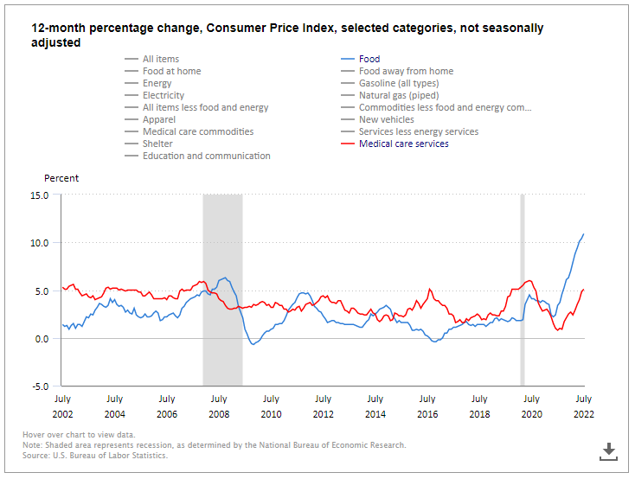
Consumer Price Index
Notes:
The Consumer Price Index is used to help calculate Inflation (i.e. the overall general upward price movement of goods and services in an economy). Prices tend to increase over time, resulting in a decrease of your purchasing power. It’s a hot topic right now as we’ve all noticed higher prices for things like gas, groceries and other common goods. Consumer prices are up 8.5% for the year ended March, 2022. That’s the largest 12-month advance since December of 1981.¹ Inflation can hit retirees particularly hard. While working, we expect that wages will keep up with inflation. After retirement, our savings will need to keep pace with price increases.
What this chart is showing is a comparison of the Consumer Price Index of food vs. Medical Care. Typically, price increases of medical care outpace overall inflation. You can see the red line (medical care) is generally above food (the blue line). What’s interesting is that when you look at July of 2022, the rising cost of food (the blue line) is actually outpacing that of medical care (the red line). Why?
Many health-care payments are determined by government programs, not market rates. In the private market, health-care services are often covered by long-term contracts. Agreements between employers and health insurers, or between insurers and doctors, are negotiated in advance and may take years for prices to adjust. That means a rise in health-care prices may be around the corner. And you can see that trend in years past, when the blue line gets above the red, it doesn’t seem to stay there for long before it corrects.
So, bottom line – we need to prepare for rising costs.
¹ Bureau of Labor Statistics, U.S. Department of Labor, The Economics Daily, Consumer prices up 8.5 percent for year ended March 2022 at https://www.bls.gov/opub/ted/2022/consumer-prices-up-8-5-percent-for-year-ended-march-2022.htm (visited September 12, 2022).
2 U.S. Department of Labor statistics, Consumer Price Index medical expenses 1998-2019

Slide 8
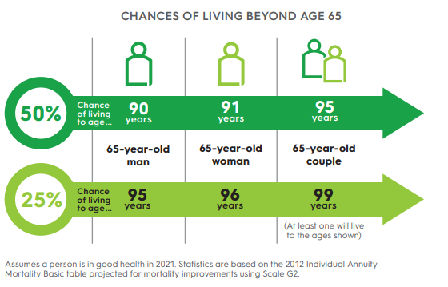
Living longer
Notes:
We also need to prepare to live longer! It’s not uncommon to meet someone over age 90 when at one time, it was a rarity. Perhaps you or someone you know has a family member over age 100? (Ask audience for personal stories…)
Here’s one way of looking at increased longevity.
• At age 65, there’s a 50% chance of living to age 90 for males, age 91 for females, and for couples, at least one spouse may live to age 95.
• At age 65, There’s a 25% chance of living to age 95 for males, age 96 for females and for couples at least one spouse may live to age 99.
Living longer requires more assets, right? More money to live, more money to pay for necessary expenses like healthcare and more time to experience rising prices like we talked about on the last slide.

Slide 9
Conditions to be aware of as we age
Cardiovascular disease
Cerebrovascular disease (strokes)
High blood pressure (hypertension)
Cancer
Type 2 diabetes
Parkinson’s disease
Dementia
Chronic obstructive pulmonary disease
Osteoarthritis
Osteoporosis
Cataracts
Age-Related macular degeneration
Hearing loss
Covid-19
Notes:
We know as we get older there are likely to be more “issues” that come up. Hopefully as few as possible, but it’s just a reality we all face as we age.
Here is a list of common conditions that can increase with age. They include cardiovascular disease, strokes, high blood pressure, cancer, type 2 diabetes, and Parkinson’s, just to name a few. Of course, we don’t know what medical issues we may face as we get older.
It’s so important to have regular doctor visits to stay on top of your health. And, of course, living a healthy lifestyle with diet and exercise can help keep stave off some of these conditions and hopefully keep medical costs down.

Slide 10
Alzheimer’s & Dementia
Living with disease
Cost
More than 6 million living with the disease
  Projected to rise to nearly 13 million by 2050
1 in 3 seniors die with Alzheimer’s or another dementia
In 2022:
  Alzheimer’s and other dementias will cost the nation $321 billion.
  By 2050 these costs could rise to nearly $1 trillion
  1 Alzheimer’s Association 2022 Alzheimer’s Disease Facets and Figures. https://www.alz.org/media/Documents/alzheimers-facts-and-figures-infographic.pdf
Notes:
While medical expenses in retirement need to cover a host of conditions, we know that the risk of Alzheimer’s and related dementia increase with age – and can be particularly challenging to find and pay for related care.
More than 6 million live with the disease and this is expected to increase to nearly 13 million by the year 2050.
1 in 3 seniors die with Alzheimer’s or another dementia.
According to the Alzheimer’s Association, the average cost of dementia care is $350,174.
This is definitely something that needs to be thought about and planned for.

Slide 11
What you can do now
Notes:
We’ve discussed health care costs in retirement and why they are increasing.
Let’s recognize that there are some things outside of your control but there are some things that you can manage.

Slide 12
Prioritize health care costs
Before retirement
After retirement
Build a retirement budget
Include Medicare and insurance premiums in the budget
Anticipate medical surprises
Manage your health
Consider health savings account
Understand what’s covered by Medicare and supplemental insurance
Manage your health
Notes:
You can manage health care costs by doing a few things before you retire. First, make sure that as you consider your retirement income budget, you factor in the cost of health care. Include Medicare premiums and because Medicare doesn’t pay for everything, include the cost of supplemental insurance, and other things that might not be covered (like dental costs and hearing aids if needed). Your preparation should include an emergency fund for medical surprises.
After retirement, have a good understanding of what’s covered by your Medicare and insurance policy before any procedure.
Both before and after retirement, manage your health and make it a priority. Living a healthy lifestyle can save a lot on healthcare expenses over time. Of course, being healthier also gives you a longer life expectancy which means incurring health care costs for those additional years of life. You can see why managing your health is intertwined with managing your finances!

Slide 13
Working with a financial professional
Working with a financial professional can increase confidence in retirement decisions.
Assist managing risks
Consider health care costs
Adjust strategy as needed
Notes:
Working with a financial professional can help you to retire with confidence. You probably want to feel excited, confident, happy and cautiously optimistic about retirement. Working with a professional can help get you there.
A financial professional can help you to bring all of the moving pieces together. They can help you to create an income strategy and adjust it as needed.

Slide 14
Schedule a conversation
One hour complimentary, no obligation, consultation
Confidential
Couples welcome
Notes:
Optional Slide.
Thank you for your time today. We covered some important retirement topics.
As I mentioned at the beginning of the session, I would be happy to meet with you for a complementary consultation to go over your personal retirement plan. There is no obligation to take advantage of this offer or to purchase financial products.
Everything that we discuss is confidential.
For those of you with a partner in life, retirement strategies should be created together.
See me after this session to schedule an appointment.

Slide 15
This is a general communication for informational and educational purposes. The information is not designed, or intended, to be applicable to any person's individual circumstances. It should not be considered investment advice, nor does it constitute a recommendation that anyone engage in (or refrain from) a particular course of action. If you are seeking investment advice or recommendations, please contact your financial professional.
This information is a general discussion of the relevant federal tax laws provided to promote ideas that may benefit a taxpayer. It is not intended for, nor can it be used by any taxpayer for the purpose of avoiding federal tax penalties. Taxpayers should seek the advice of their own advisors regarding any tax and legal issues specific to their situation.
Insurance products are issued by Minnesota Life Insurance Company or Securian Life Insurance Company, a New York authorized insurer. Minnesota Life is not an authorized New York insurer and does not do insurance business in New York. Both companies are headquartered in St. Paul, MN. Securities and investment advisory services offered through Securian Financial Services, Inc., member FINRA/SIPC, 400 Robert Street North, St. Paul, MN 55101-2098, 1-800-820-4205.
Securian Financial is the marketing name for Securian Financial Group, Inc., and its subsidiaries. Minnesota Life Insurance Company and Securian Life Insurance Company are subsidiaries of Securian Financial Group, Inc.
Securian Financial Group, Inc.
securian.com
400 Robert Street North, St. Paul, MN 55101-2098
©2019-2022 Securian Financial Group, Inc. All rights reserved.
Rev 9-2022 DOFU 9-2022
2421226

