Slide 1
AccumuLink™ Advance A next generation Registered Index-Linked Annuity
Insurance products issued by:
Minnesota Life Insurance Company
For financial professional use only. Not for use with the public.
May not be reproduced where it is accessible to the general public.
Notes:
Good morning, everyone, and thank you for being here today. I’m excited to introduce you to a new solution we believe will help you meet the evolving needs of your clients: AccumuLink Advance, our next-generation Registered Index-Linked Annuity, or RILA.

Slide 2
Agenda
Retirement challenges
Registered Index Linked Annuity (RILA) marketplace
Meet AccumuLink AdvanceTM
Sales tools and resources
About Securian Financial
Notes:
In the next 20 minutes, I’ll walk you through the changing retirement landscape, how RILAs fit into the picture, what makes AccumuLink Advance unique, and the tools and support we’ve built to help you bring this opportunity to your clients.
Let’s get started.

Slide 3

Retirement Challenges
Notes:
Let’s start with the problem: the way we used to plan for retirement is no longer working.

Slide 4
Retirement Challenges
Retirement has changed
Investment conditions
Old strategies may not cut it
Health care
X-factor
Uncertain future of Social Security benefits
People are working longer
Market volatility
Low fixed yields relative to inflation
4% rule may risk principal
Uncertainty with 60/40 portfolio
Significant costs could make or break retirement
One in five Americans is expected to be 65 years old or older by 2030.
Source: Castroverde, Jasmine; Portes, Ronamil. “1 in 5 Americans to be 65 years old or older by 2030” S&P Global. Published November 14, 2024.
Notes:
We all know retirement planning today doesn’t look like it did 20 or even 10 years ago. The rules have changed.
The future of Social Security is uncertain. People are working longer, not always by choice. The markets are volatile, and yields on fixed income investments have struggled to keep pace with inflation.
The once-popular 4% rule could actually put principal at risk now. And let’s not forget healthcare—one of the biggest unknowns in retirement. These factors can make or break retirement success.
In fact, by 2030, one in five Americans is expected to be 65 or older. The need for smarter solutions is growing fast.

Slide 5
Market Dynamics Create Opportunity
Elevated interest rates drive improved cap and participation rates.
Continued market volatility increases demand for downside protection.
Investors seek structured solutions in uncertain economic environments.
Notes:
But challenge also creates opportunity. Elevated interest rates mean we can offer stronger cap and participation rates.
And with persistent market volatility, more and more clients are seeking solutions that offer downside protection while still giving them a chance to grow.
Structured solutions like RILAs are gaining traction with clients who want a smoother ride to retirement.

Slide 6
What is a RILA
Notes:
So, what exactly is a RILA?

Slide 7
What is a RILA
RILA = registered index-linked annuity
A variable annuity offering growth potential linked to the performance of market indices while providing partial level of downside protection.
A retirement product designed with direct trade-offs to either upside potential or downside protection.
Size of the market: Registered index-linked annuity (RILA) set a new quarterly sales record. In the 2nd quarter of 2025, RILA sales were $19.6 billion, 20% higher than the prior year.
Source: https://www.limra.com/en/newsroom/news-releases/2025/limra-u.s.-annuity-sales-set-new-record-in-first-half-of-2025/
Notes:
A Registered Index-Linked Annuity is a variable annuity that offers growth potential based on the performance of market indexes, while providing partial downside protection.
Clients trade off some upside or accept certain limits, in exchange for a cushion against loss.
And this market is booming. RILA sales grew 20% year over year, reaching $19.6 billion in the second quarter of 2025. That tells us clients are ready for something new.

Slide 8
Lower Growth Potential
Higher Growth Potential
Fixed Annuities
Fixed Indexed Annuities
Variable Annuities
Mutual Funds
Cash
Bonds
RILAs
Stocks
100% Protection
Lower Risk
Moderate Risk
Higher Risk
Fixed indexed annuities and fixed annuities typically offer 100% protection for the purchase payment against market downturns. Purchase payments may be subject to withdrawal charges and market value adjustments.
Notes:
It helps to think about where RILAs sit on the investment spectrum.
On one side, you have equities—stocks, mutual funds, variable annuities—offering high growth potential but with significant risk. On the other, you have fixed annuities and fixed indexed annuities, which offer full principal protection but limited growth.
RILAs offer a strategic middle ground. They help clients participate in market gains, while also reducing risk exposure.

Slide 9

RILA clients are typically…
Pre-retirees and recent retirees who want market participation for growth but cannot afford significant losses as they approach or enter retirement.
Clients seeking portfolio diversification by reducing overall volatility while maintaining market participation.
Clients with moderate risk tolerance who understand the trade-off of upside potential and downside protection, especially those with a longer time horizon.
Notes:
So, who is the ideal RILA client?
First, it’s pre-retirees or recent retirees who still want market participation but can’t afford large losses.
Second, clients looking for portfolio diversification and a reduction in volatility.
And third, people with moderate risk tolerance who understand the trade-off of upside potential versus downside protection—especially those with a longer time horizon.

Slide 10
AccumuLinkTM Advance
Notes:
This is not just another RILA. It’s designed to solve multiple pain points with smart crediting strategies, flexibility, and new client-focused benefits.

Slide 11

Introducing AccumuLink™ Advance
A next generation registered index-linked annuity (RILA) with a mission to create a combination of features and benefits clients haven’t seen before.
AccumuLink Advance overview
Indexing Strategies
Optional riders
Sales ideas
Product specifications and details
Notes:
This is our next-generation RILA, designed to combine features and benefits that clients haven’t seen together before.
We’re talking about innovation that delivers flexibility, growth potential, and meaningful downside protection—all in one product.

Slide 12
Crediting methods by term
1-year indexed account options
 |  | S&P 500 | MSCI EAFE | NASDAQ-100 | JEDI
0% Floor | Cap | x
1% Buffer | Participation rate | x | x | x | x
10% Buffer | Cap | x | x | x
 | Participation rate | x | x | x | x
20% Buffer | Cap | x
 | Participation rate | x | x | x | x
10% Shift | Participation rate | x
There is also a fixed rate strategy available.
6-year indexed account options
 |  | S&P 500 | MSCI EAFE | NASDAQ-100 | JEDI
1% Buffer | Participation rate | x | x | x | x
10% Buffer | Participation rate | x
20% Buffer | Participation rate | x | x | x
Six-year option is only available at contract issue.
Notes:
A combination of underlying indexed accounts lets clients strike the right balance between risk and return for their specific needs. Clients can choose how to allocate their assets between the indexed accounts.
Before we dive in, let’s take a look at the complete range or crediting methods offered in Accumulink Advance.
You’ll note, there are two strategies in Accumulink Advance that you might not be familiar with: the 1% buffer and the 10% Shift …

Slide 13
Three things we think your clients will really love!
Accumulink™ advance Marketing Launch Plan
Small buffer. Big potential.
The innovative shift
Alleviate chronic or terminal illness concerns
1% buffer crediting strategy
The Shift crediting strategy
An optional Accelerated Death Benefit rider
Notes:
While Accumulink Advance offers many of the features you’ve come to expect from a RILA, there are three meaningful features that you might not have seen before – and perhaps, these will help create additional business opportunities for you with your clients.
Number one: our 1% buffer crediting strategy. We knew it would be important to distinguish ourselves with this new product. We looked at the current RILA marketplace and it became clear we could make an impact by offering an index crediting method utilizing a participation rate rather than a cap. Financial professionals tend to think of index crediting as synonymous with upside limitations. Either because of a hard cap or a participation rate that only gives a percentage of the index return. The great thing about our product is you have the ability to out earn the index returns. There is no cap and a competitive participation rate can potentially give clients more than what the index returns.
Number two: We wanted an index crediting strategy that could provide value in all market conditions and our shift index crediting strategy does. No matter what the index return is, the shift adds 10% if that return is greater than 0, we multiply it by a participation rate. Let's look at an example. Say the tracked index is down 12%, the index adds 10%, which results in a smaller loss of 2%. Now let's say the track index is up 8%. The shift adds 10%, so we multiply 18% by a 60% par rate, resulting in a credit of 10.8%. What clients will love about the shift is it will help smooth out their journey, turning bad years into manageable bumps and having the potential to elevate good years.
And number three: a chronic illness benefit that addresses one of the most common retirement fears—getting sick and running out of money. Clients tend to worry about an illness wiping out their retirement savings. They may feel good about where they are currently, but an nagging question persists. What happens if I get sick? AccumuLink™ Advance is the first registered index linked annuity in the industry to offer an optional death benefit rider for chronic or terminal illness, for an additional cost with no underwriting.

Slide 14
1% Buffer
In a year in which the index is negative, the loss will be reduced by the stated 1% buffer rate.
Small buffer. Big potential
Most RILAs don’t have a 1% buffer. It might sound small, but it offers significant upside potential.
In a year in which the index is positive, your annuity will receive a credit multiplied by a participation rate.
Hypothetical example for illustrative purposes only.
Notes:
Let’s talk more about the 1% buffer. Most RILAs don’t offer this small a buffer.
Why is that important? Because it allows for significantly higher upside potential through participation rates. It’s a strategic way to balance risk and reward.
Here’s how it works: if the index is negative, the 1% buffer reduces the loss. If the index is positive, your client receives a credit based on the participation rate.
We knew it would be important to distinguish ourselves with this new product. We looked at the current RILA marketplace and it became clear we could make an impact by offering an index crediting method utilizing a participation rate rather than a cap. Financial professionals tend to think of index crediting as synonymous with upside limitations. Either because of a hard cap or a participation rate that only gives a percentage of the index return. The great thing about our product is you have the ability to out earn the index returns. There is no cap and a competitive participation rate can potentially give clients more than what the index returns.

Slide 15
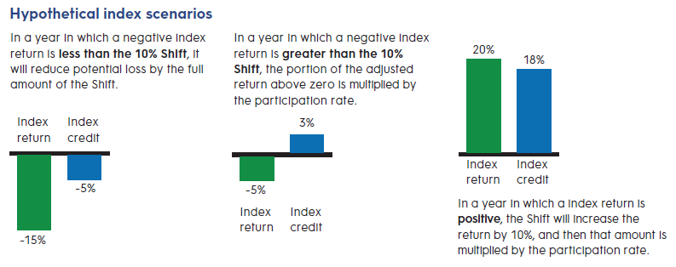
The Shift
The innovative shift
The shift crediting strategy adds 10% to the index return – making a bad year manageable or a good year great
A participation rate is applied to index returns greater than zero.
Notes:
Next, the Shift strategy. This one’s a game-changer.
We wanted an index crediting strategy that could provide value in all market conditions and our shift index crediting strategy does. No matter what the index return is, the shift adds 10% if that return is greater than 0, we multiply it by a participation rate. Let's look at an example. Say the tracked index is down 15%, the index adds 10%, which results in a smaller loss of 5%. Now let's say the track index is up 20%. The shift adds 10%, so we multiply 18% by a 60% par rate, resulting in a credit of 10.8%. What clients will love about the shift is it will help smooth out their journey, turning bad years into manageable bumps and having the potential to elevate good years.

Slide 16

Optional Benefits
Accelerated Death Benefit Rider¹: [0.75% (1.15% if age at issue is 71 or older)]
Return of Purchase Payments Death Benefit Rider: [0.15% (0.40% if age at issue is 71-or older)]
1. In Illinois, Texas and Virginia, this rider is named the Roll-up Death Benefit with Enhanced Surrender Value Rider. Please refer to the state specific AccumuLink Advance Accelerated Death Benefit and Roll-up Death Benefit flyers (available on our financial professional website) for specific terminology used in each state.
Notes:
This RILA goes beyond accumulation – it also offers meaningful protection. Clients tend to worry about an illness wiping out their retirement savings. They may feel good about where they are currently, but an nagging question persists. What happens if I get sick? AccumuLink™ Advance is the first registered index linked annuity in the industry to offer an optional death benefit rider for chronic or terminal illness, for an additional cost with no underwriting.
Let’s take a closer look at the Accelerate Death Benefit – which might be of great interest to your clients.

Slide 17
Overcome THAT concern
HOW THE 6% ROLL-UP AND DEATH BENEFIT ACCELERATION WORK
$215,000
Contract value is adjusted up to the Enhanced Surrender Value when the
AccumuLink™ Advance offers an optional Accelerated Death Benefit Rider¹ , for an addtional cost, that can help address chronic or terminal illness concerns. It features a 6% roll-up with no underwriting.
$195,000
benefit is activated. The adjustment is placed into the Fixed Account.
$175,000
$155,000
$135,000
Contract value
Fixed account value Acceleration period
Death benefit
$115,000
$95,000
$75,000
1
2
3
4
5
6
7
8
9
10
11
12
Year
1. In Illinois, Texas and Virginia, this rider is named the Roll-up Death Benefit with Enhanced Surrender Value Rider. Please refer to the state specific AccumuLink Advance Accelerated
Death Benefit and Roll-up Death Benefit flyers (available on our financial professional website) for specific terminology used in each state.
This hypothetical example is for illustrative purposes only. It is not indicative of any particular time period or guarantee of future performance.
The Accelerated Death Benefit Rider is not long-term care insurance. It is not a qualified benefit under the Internal Revenue Code. An individual may not purchase this optional death benefit rider if they are currently in a nursing home, skilled nursing facility or unable to perform any one of the six ADLs. The Accelerated Death Benefit Rider provides an option to accelerate death benefit proceeds in the event that the owner becomes chronically or terminally ill. (You should consult the application for eligibility criteria.)
Withdrawals or surrender of contract value during the acceleration period will be subject to taxation in the same manner as any other withdrawal. (You may wish to consult your tax advisor before electing to accelerate your benefit.)
Notes:
And now let’s address that big concern: chronic or terminal illness.
We all know how fast an illness can derail a retirement plan. That’s why offer an optional Accelerated Death Benefit Rider that helps address chronic or terminal illness concerns.
It features a 6% roll-up and no underwriting.
Just remember, it’s not long-term care insurance, but it can provide real peace of mind.

Slide 18

AccumuLink™ Advance
Issue age:
Maximum 85
Purchase payments:
$25,000 minimum initial, up to $2 million maximum in purchase payments
Notes:
Let’s quickly review the specs.
Issue age is up to 85. Minimum purchase is $25,000. We accept up to $2 million in total purchase payments.

Slide 19
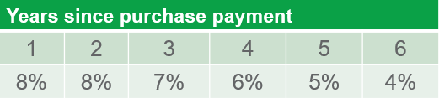

Surrender charge on withdrawal:
The surrender charge decreases from 8% to 4% over the 6-year period. After this, there is no surrender charge.
Withdrawals prior to age 59½ may incur a 10% IRS tax penalty in addition to income tax.
Notes:
Surrender charges start at 8% and drop to 4% over six years. After that, there’s no charge.
And yes, withdrawals before age 59 and a half may incur a 10% IRS penalty.

Slide 20
Waiver of surrender charge
After the first contract anniversary for the following qualifying events:
Annuitization
Death
Withdrawal or surrender during a qualifying nursing home stay or terminal condition of the owner or joint owner. There is a one-year waiting period following any change of ownership during which these waiver provisions do not apply.
Required Minimum Distribution (RMD) in excess of Free Withdrawal amount per contract year.
Please review the prospectus for complete details about qualifying events for waiver of surrender charge.
Notes:
Read slide

Slide 21
Three things we think your clients will really love!
Accumulink™ advance Marketing Launch Plan
Small buffer. Big potential.
The innovative shift
Overcome THAT concern
1% buffer crediting strategy
The Shift crediting strategy
An optional Accelerated Death Benefit Rider
Notes:
Hopefully by now, you have started to imagine some clients or prospective clients who might really find value in these opportunities within Accumulink Advance …
Small buffer, big potential – 1% buffer with competitive participation rate.
A big head start – The Shift strategy adds 10% to index returns – a participation rate on positive returns. And no cap to limit upside potential, and …
The Accelerated Death Benefit Rider– An optional death benefit rider with no underwriting that can help alleviate concerns over Chronic or Terminal Illness.

Slide 22

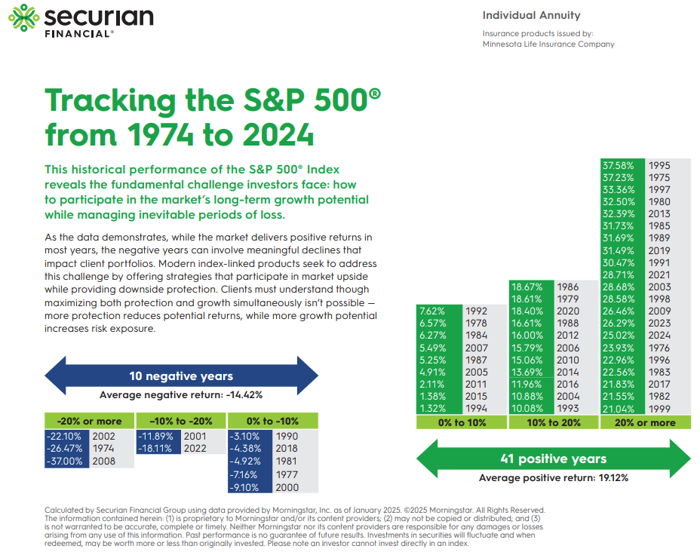
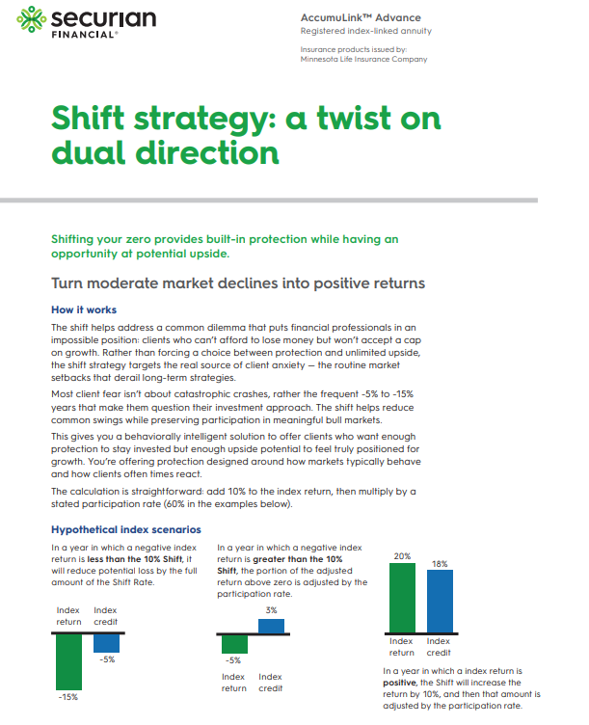

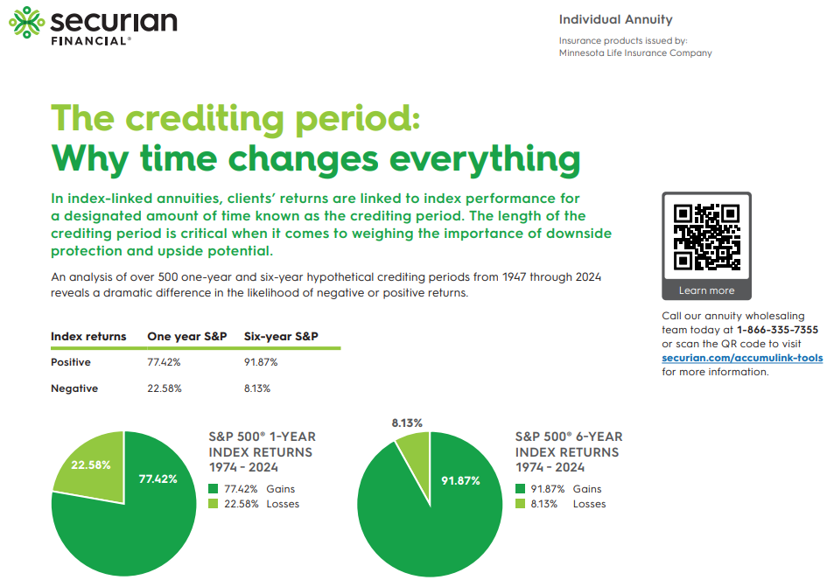
Get started with AccumuLink Advance
FinPro Overview
Tracking S&P sales idea
Shift strategy
Crediting period sales idea
Notes:
We know RILAs can seem complex, so we’ve built tools to help you simplify the conversation.
Scan the QR code to access these materials and more!

Slide 23
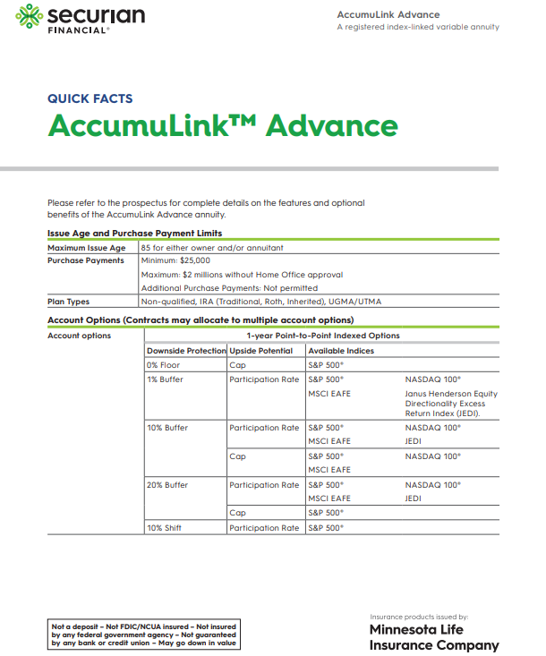
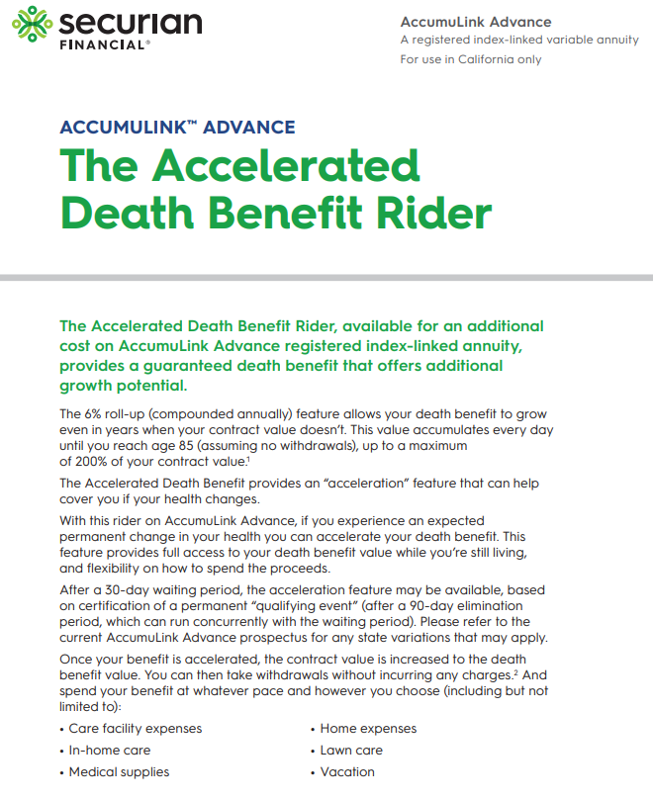

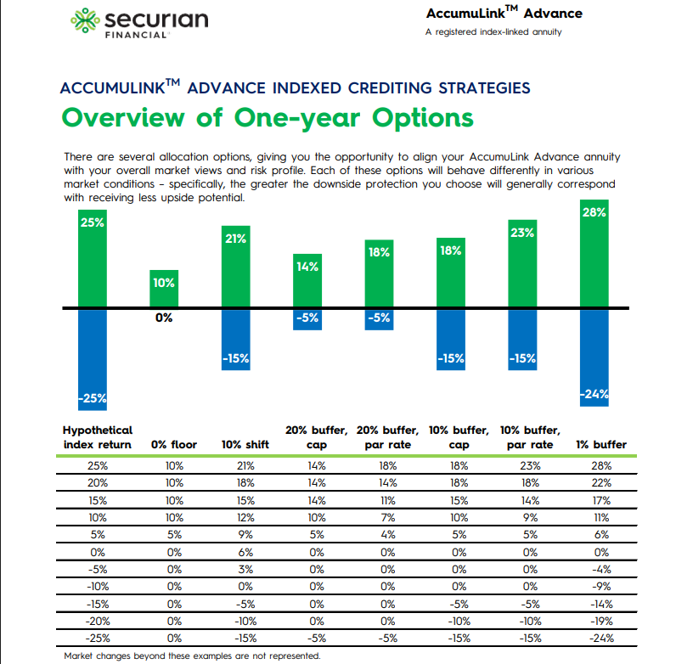

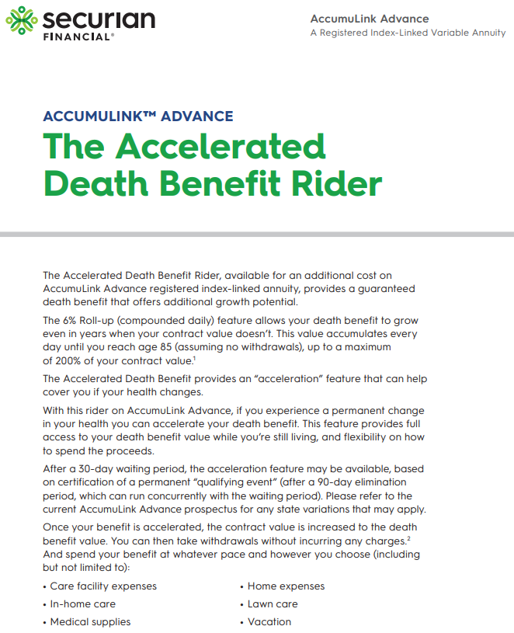
AccumuLink consumer presentation materials
Quick facts
Death benefit - CA
Consumer brochure
Crediting strategies overview
Death benefit
Notes:
And, to help you close cases and get a fast start – we’ve created tools that will help you client more quickly understand how AccumuLink might fit into their overall financial strategies.
Scan the QR for these materials and more!

Slide 24
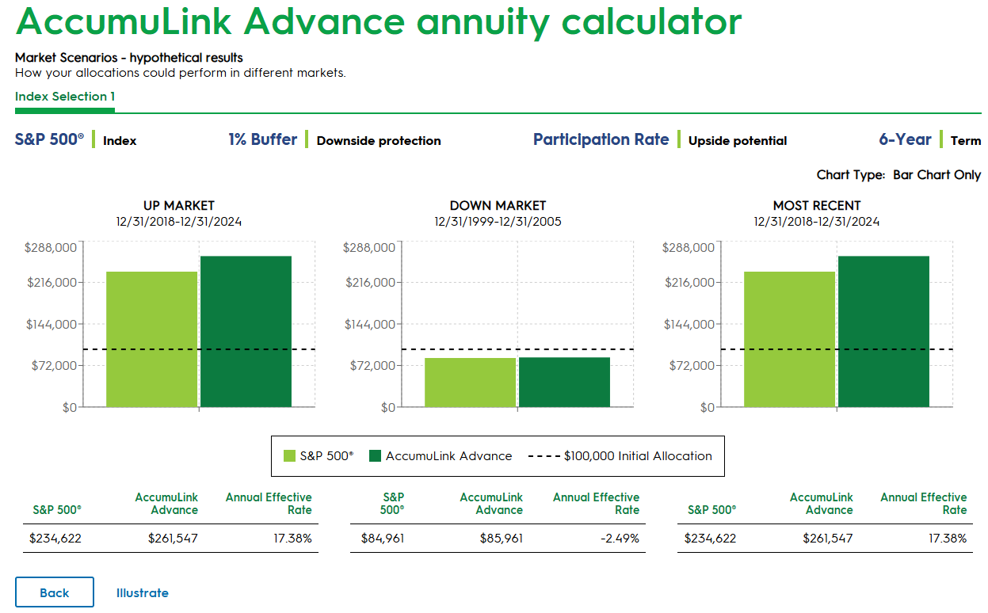
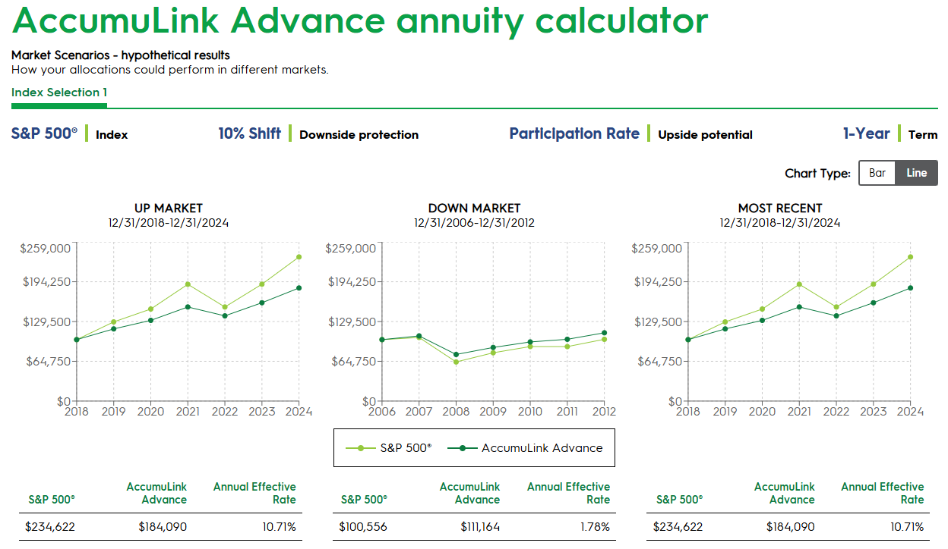
Interact with AccumuLink Indexed Account Strategies
Curious about how the indexed account strategies work, or how they would work together in different market scenarios?
This interactive tool can help you see how combinations of strategies might provide some buffer when an index is down or help your client capture index gains.
Notes:
You know your clients' situations better than anyone else. We built a tool where you can mix and match different strategies to see how they might interact with one another and ultimately serve your clients. Wherever they end up falling on the spectrum of downside protection and upside potential, see how AccumuLink Advance might fit into their portfolio.
Built next to our illustrations system, it allows you to visualize what those quotes might look like.
Scan the QR to see more.

Slide 25
A.M. Best Company rating (second highest of 16 ratings); Fitch rating (third highest of 19 ratings); Moody’s rating (fourth highest of 21 ratings); Standard & Poor’s rating (fourth highest of 21 ratings). For more information about the rating agencies and to see where our ratings rank compared to other ratings, please see our website at securian.com/ratings. Ratings for financial strength and claims-paying ability are important; however they are not reflective of the performance of any registered securities or variable subaccounts. All ratings information as of April 2024.
F74547-2 Rev 12-2024 DOFU 12-2024
3972287
Notes:
Finally, let’s talk briefly about Securian Financial.
Our financial strength is backed by strong ratings from the top four agencies.

Slide 26
About Securian
All statistics are as of December 31, 2024. GAAP (generally accepted accounting principles) is a collection of commonly followed accounting rules and standards for financial reporting.
1. Total investments include cash, cash equivalents and invested assets, and exclude separate accounts.
2. Revenue includes premiums and policy fee income, net investment income, realized gain/loss and other income.
3. Reflects total GAAP policyholder benefits and interest credited to policies and contracts.
4. Equity represents total Securian Financial Group, Inc. and subsidiaries equity.
5. Our total impact reached more than 760 nonprofits in the form of foundation and other cash contributions, in-kind donations and volunteerism.
F76646-18 Rev 2-2025. DOFU 4-2024
3503820
Notes:
The size, and financial strength of Securian Financial help make us a valued partner in your work with your clients, helping them building toward a secure tomorrow.

Slide 27



Are you ready to add AccumuLink Advance to your practice?
Visit securian.com/accumulink
Or call the Annuity Sales Desk:
1-866-335-7355
Notes:
So, are you ready to add AccumuLink Advance to your practice?
Reach out to your Securian contact, visit securian.com/accumulink, or call the annuity sales desk to get started.

Slide 28
Notes:
Thank you again for your time today. I look forward to seeing how AccumuLink Advance can help you grow your practice and deliver even more value to your clients.

Slide 29


Slide 30
Disclosures
An annuity is intended to be a long-term, tax-deferred retirement vehicle. Earnings are taxable as ordinary income when distributed, and if withdrawn before age 59½, may be subject to a 10 percent federal tax penalty. If the annuity will fund an IRA or other tax qualified plan, the tax deferral feature offers no additional value. Qualified distributions from a Roth IRA are generally excluded from gross income, but taxes and penalties may apply to non-qualified distributions. Please consult a tax advisor for specific information. There are charges and expenses associated with annuities, such as surrender charges (deferred sales charges) for early withdrawals.
Registered index-linked annuities are subject to ongoing fluctuations in value, and it is possible to lose a significant amount of principal due to negative index performance or a negative interim value adjustment. All guarantees provided under this contract, including optional guaranteed death benefits, the crediting of any index credits earned at the end of a crediting period, interest, and annuity payments are subject to the financial strength and claims-paying ability of Minnesota Life Insurance Company. The guarantees have no bearing on the performance of any index that underlies an indexed account.
The Caps and Participation Rates offered may differ between new issue contracts and in-force contracts. The rates you receive will vary from crediting period to crediting period, but will never be less than any contractually guaranteed minimums. We will notify you of the current renewal rates for any available indexed accounts in advance of your expiring crediting period. Except for the Default Account, we may discontinue any indexed account option offered under the contract at the end of a crediting period.
Indexed accounts have a daily interim value adjustment that may be negative or positive and causes an indexed account’s value to fluctuate daily. The interim value adjustment may be negative, even if the underlying index performance is positive. A negative interim value adjustment may result in losses to your initial investment and previous index credits earned. The protection provided by a Buffer, Floor, or Shift is only applied if funds are held in an indexed account until the crediting period is completed. Index credits are only applied if funds are held until the completion of a crediting period.

Slide 31
Disclosures
Fees for optional benefits will be deducted from your account value, and if deducted prior to the end of a multi-year crediting period, will reduce the amount of index credits you may receive at the end of a crediting period.
Accelerated Death Benefit Rider is not long-term care insurance. It is not a qualified benefit under the Internal Revenue Code. An individual may not purchase this optional death benefit rider if they are currently in a nursing home, skilled nursing facility or unable to perform any one of the six ADLs. The Accelerated Death Benefit Rider provides an option to accelerate death benefit proceeds in the event that the owner becomes chronically or terminally ill. (You should consult the application for eligibility criteria.)
Registered index-linked annuities are sold by prospectus. Your clients should consider the investment objectives, risks, charges and fees of the product carefully before investing. Please see the registered index-linked product prospectus for this, and other important, information.
These materials are for information and educations purposes only and are not designed or intended to be applicable to any person's individual circumstances. It should not be considered investment advice, nor does it constitute a recommendation that anyone engage in (or refrain from) a particular course of action. Securian Financial Group, Inc. and its subsidiaries have a financial interest in the sale of their products.
S&P® is a registered trademark of Standard & Poor’s Financial Services LLC (“S&P”) and Dow Jones® is a registered trademark of Dow Jones Trademark Holdings LLC (“Dow Jones”). The foregoing trademarks have been licensed for use by S&P Dow Jones Indices LLC. S&P® and S&P 500® are registered trademarks of S&P and have been licensed for use by S&P Dow Jones Indices LLC and Minnesota Life Insurance Company (“Minnesota Life”). The S&P 500® index is a product of S&P Dow Jones Indices LLC and has been licensed for use by Minnesota Life. Minnesota Life Annuities are not sponsored, endorsed, sold or promoted by S&P Dow Jones Indices LLC, Dow Jones, S&P or their respective affiliates and neither S&P Dow Jones Indices LLC, Dow Jones, S&P nor their respective affiliates make any representation regarding the advisability of investing in such product(s). Index performance, if shown, does not include dividends.
Nasdaq®, Nasdaq-100 Index®; Nasdaq-100®l NDX®, are registered trademarks of Nasdaq, Inc. (which with its affiliates is referred to as the “Corporations”) and are licensed for use by Minnesota Life Insurance Company. The Product(s) have not been passed on by the Corporations as to their legality or suitability. The Product(s) are not issued, endorsed, sold, or promoted by the Corporations. The Corporations make no warranties and bear no liability with respect to the product(s).

Slide 32
Disclosures
The Janus Henderson Equity Directionality Excess Return Index is the exclusive property of Janus Henderson Indices LLC. All Janus Henderson names, logos and website “https://indices.janushenderson.com” are service marks of Janus Henderson Group plc and have been licensed for use by Minnesota Life Insurance Company. Neither Janus Henderson Indices LLC (“Janus Henderson”) nor any other party makes any representation or warranty, express or implied, to the owners of the Product or any member of the public regarding the advisability of investing in the Product generally or the similarities or variations between the performance of the Product or the Index and the performance of the underlying securities or financial instruments. Janus Henderson is the licensor of certain trademarks, service marks and trade names of Janus Henderson. Neither Janus Henderson nor any other party guarantees the accuracy and/or the completeness of the indices or any data included therein or any calculations made with respect to the Product. Janus Henderson disclaims all warranties of merchantability or fitness for any particular purpose with respect to the indices or any data included therein.
ALTHOUGH JANUS HENDERSON SHALL OBTAIN INFORMATION FOR INCLUSION IN OR FOR USE IN CALCULATIONS RELATED TO THE PRODUCT FROM SOURCES WHICH JANUS HENDERSON CONSIDERS RELIABLE, NEITHER JANUS HENDERSON NOR ANY OTHER PARTY GUARANTEES THE ACCURACY AND/OR THE COMPLETENESS OF THE INDICES OR ANY DATA INCLUDED THEREIN OR ANY CALCULATIONS MADE WITH RESPECTÏ THE PRODUCT. NEITHER JANUS HENDERSON NOR ANY OTHER PARTY MAKES ANY WARRANTY, EXPRESS OR IMPLIED, AS TO RESULTS TO BE OBTAINED BY LICENSEE, LICENSEE’S CUSTOMERS AND COUNTERPARTIES, HOLDERS OF THE PRODUCT, OR ANY OTHER PERSON OR ENTITY FROM THE USE OF THE INDICES OR ANY DATA INCLUDED THEREIN OR ANY CALCULATIONS MADE WITH RESPECT TO THE PRODUCT INÜONNECTION WITH THE RIGHTS LICENSED HEREUNDER OR FOR ANY OTHER USE. NEITHER JANUS HENDERSON NOR ANY OTHER PARTY MAKES ANY EXPRESS OR IMPLIED WARRANTIES, AND JANUS HENDERSON HEREBY EXPRESSLY DISCLAIMS ALL WARRANTIES OF MERCHANTABILITY OR FITNESS FOR A PARTICULAR PURPOSE WITH RESPECT TO THE INDICES OR ANY DATA INCLUDED THEREIN OR ANY CALCULATIONS MADE WITH RESPECT TO THE PRODUCT. WITHOUT LIMITING ANY OF THE FOREGOING, IN NO EVENT SHALL JANUS HENDERSONÏ ANY OTHER PARTY HAVE ANY LIABILITY FOR ANY DIRECT, INDIRECT, SPECIAL, PUNITIVE, CONSEQUENTIAL OR ANY OTHER DAMAGES (INCLUDING LOST PROFITS) EVEN IF NOTIFIED OF THE POSSIBILITY OF SUCH DAMAGES.

Slide 33
Disclosures
The Marks are service marks of Janus Henderson Group plc and have been licensed for use by Minnesota Life Insurance Company and its affiliates. The Product is not sponsored, endorsed, sold or promoted by Janus Henderson Indices nor does Janus Henderson Indices make any representation regarding the advisability of investing in the Product(s).
The products referred to herein are not sponsored, endorsed, or promoted by MSCI, and MSCI bears no liability with respect to any such products or any index on which such products are based. The Contract contains a more detailed description of the limited relationship MSCI has with Minnesota Life and any related products. Index performance if shown does not include dividends.
Insurance products are issued by Minnesota Life Insurance Company or Securian Life Insurance Company, a New York authorized insurer. Both companies are headquartered in St. Paul, MN. Product availability and features may vary by state. Each insurer is solely responsible for the financial obligations under the policies or contracts it issues. Securities are distributed by Securian Financial Services, Inc. Member FINRA. 400 Robert Street North, St. Paul, MN 55101-2098.
Securian Financial is the marketing name for Securian Financial Group, Inc., and its subsidiaries. Minnesota Life Insurance Company and Securian Life Insurance Company are subsidiaries of Securian Financial Group, Inc.
For financial professional use only. Not for use with the public. This material may not be reproduced in any way where it would be accessible to the general public.
Securian Financial Group, Inc.
securian.com
400 Robert St. No., St. Paul, MN 55101-2098
© 2025 Securian Financial Group, Inc. All rights reserved.
4658200PPT-0825 DOFU 8-2025
4658200

